Slide 1

This course was developed as a part of the VLIR-UOS Cross-Cutting project s:
Statistics: 2011-2016, 2017.
Statistics: 2017.
Statistics for development : 2018-2020.

Slide 2




An introduction to R: Short Version (2017)
The >eR-Biostat initiative
Making R based education materials in statistics accessible for all
Developed by
Dan Lin (Hasselt University) and Ziv Shkedy (Hasselt University)
LAST UPDATE: 15/10/2017
ER-BioStat
https://github.com/eR-Biostat
Email: erbiostat@gmail.com
@erbiostat

Slide 3
Overview
A (very) quick start: the cars data
Two sample t-test.
basic plots
Basic programming in R: objects in R
Reading external datasets
Basic plots functions
Programming in R: a for loop
Statistical modeling in R: simple linear regression
Statistical modeling in R: one-way ANOVA
Statistical modeling in R: logistic regression
Programming in R: user functions
Two-way ANOVA
More about two-way ANOVA,
More about linear regression
Application of a for loop: bootstrap.

Slide 4
A (very) quick Start

Slide 5
The R environment
Open R.
Open a new script window.

Slide 6
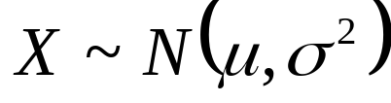
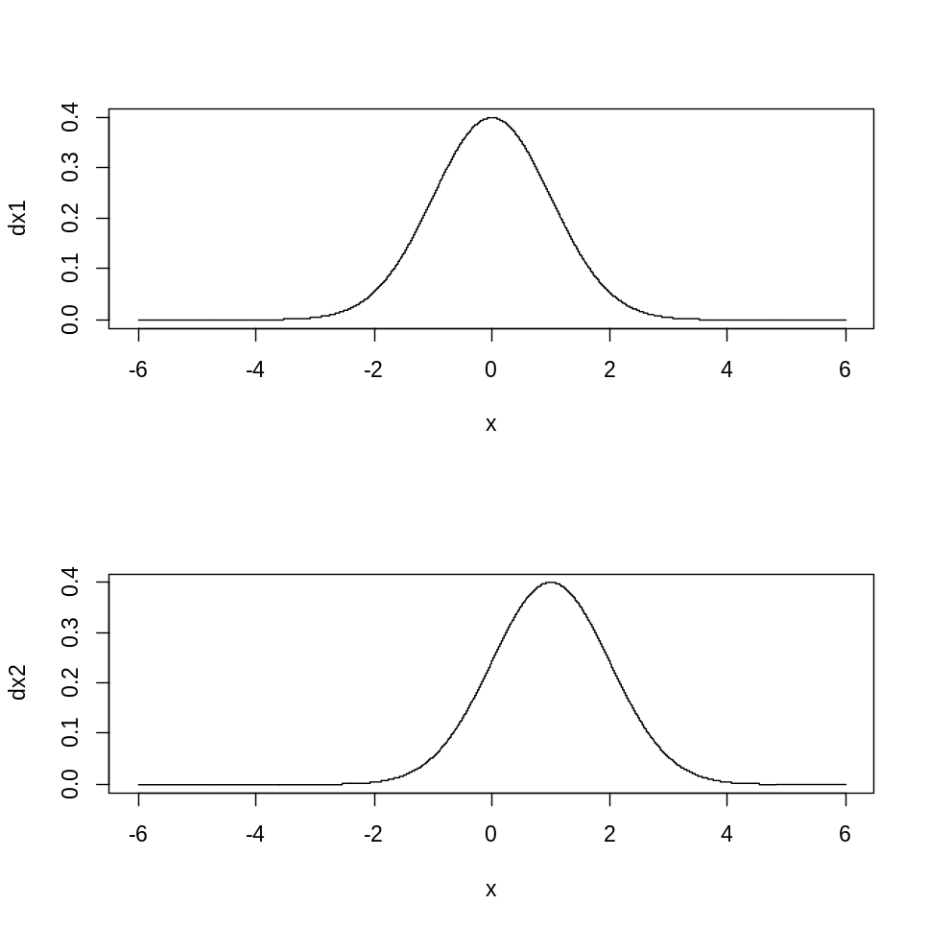
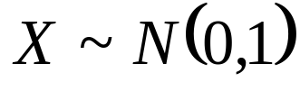

The normal distribution: location
Density function of a normal distribution

Slide 7
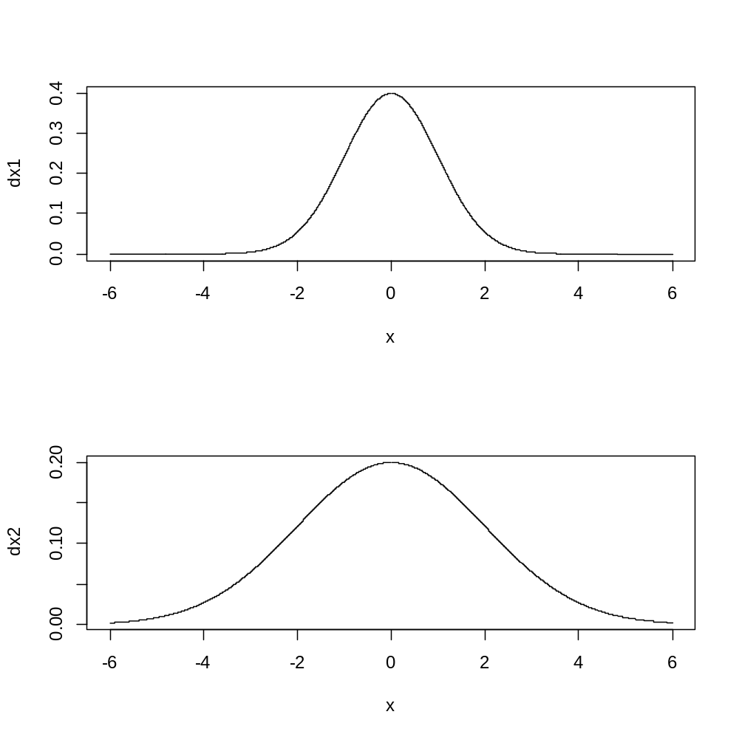

The normal distribution: variability
Density function of a normal distribution

Slide 8
Random sample from a normal distribution in R
Draw a random sample of size 100 from a normal distribution with mean – and variance 1
In R
rnorm(sample size, mean,standard deviation)
rnorm(100,0,1)

Slide 9
Random sample from a normal distribution in R
Draw a random sample of size 100 from a normal distribution with mean – and variance 1
> rnorm(100,0,1)
[1] -0.173911348 -0.463196096 -1.084838332 2.373958677 -1.685884982
[6] -1.952672126 -0.055601310 -0.241913096 -0.999586206 0.308335895
[11] 0.556993818 2.337451275 0.778734465 -0.501354458 0.004525392
[16] -1.468709822 0.109901143 0.109103689 0.662434110 -0.177097648
[21] -1.442033566 0.615239368 0.254080126 1.152977602 -0.089559002
[26] 0.065022482 0.300405204 -0.190196930 -0.244365328 0.886735849
[31] -0.667671228 -1.009209277 0.388362272 -0.041883373 0.750480061
[36] -2.103109677 -1.515839684 -0.477250540 -0.344581482 0.072570862
[41] -0.364485234 -0.920898769 1.148778190 1.092225688 -0.832389361
[46] -1.914844153 -0.384265110 0.528078353 1.319149374 0.226817654
[51] -0.605867376 -0.658048328 0.086126314 0.711404951 1.190303122
[56] 2.499314086 2.201924724 0.591527333 -0.733622099 -0.656031690
[61] -0.194759316 0.864421699 0.813854743 -0.628803589 0.362077258
[66] 0.312250497 1.451227963 1.107136623 0.680487861 1.585879056
[71] -0.249983835 -1.436293634 -0.470710524 -2.330088808 0.265551343
[76] -0.847238216 -1.199413581 -1.866542460 0.826973063 -0.592073631
[81] -1.751735134 0.077115620 -0.306869702 0.120083596 -0.303521155
[86] -0.644268518 0.295067198 2.004409939 0.310290927 0.221898330
[91] -1.450606907 -1.264043444 -0.257282348 0.078120141 -0.902925645
[96] 0.499980835 -0.596173525 -1.085097601 -0.773094391 0.693319162

Slide 10
Creating an R object
> x<-rnorm(100,0,1)
> x
[1] -1.91083203 1.04955497 -2.40884482 0.33493954 1.45434660 -2.42198672
[7] 0.44232862 -0.73804911 -0.36354587 0.39064194 -0.31993512 -1.30809569
[13] 0.11409195 0.43549125 -0.29501115 0.29197212 0.50983934 -0.80452037
[19] -0.61008244 1.80780477 1.31535974 -1.33155401 0.29044725 -0.63380504
[85] 1.03861350 0.89381884 0.86323215 -0.24199953 1.64380126 0.45445204
[91] 1.90708641 0.34088349 -0.25727644 -0.26498359 0.80095645 1.42711451
[97] 1.27998167 -0.54106317 -1.29443674 0.36046722
An R object contain the results
Print the R object

Slide 11
Summary statistics
> mean(x)
[1] 0.02149641
> var(x)
[1] 1.061159
Sample mean
Sample variance

Slide 12
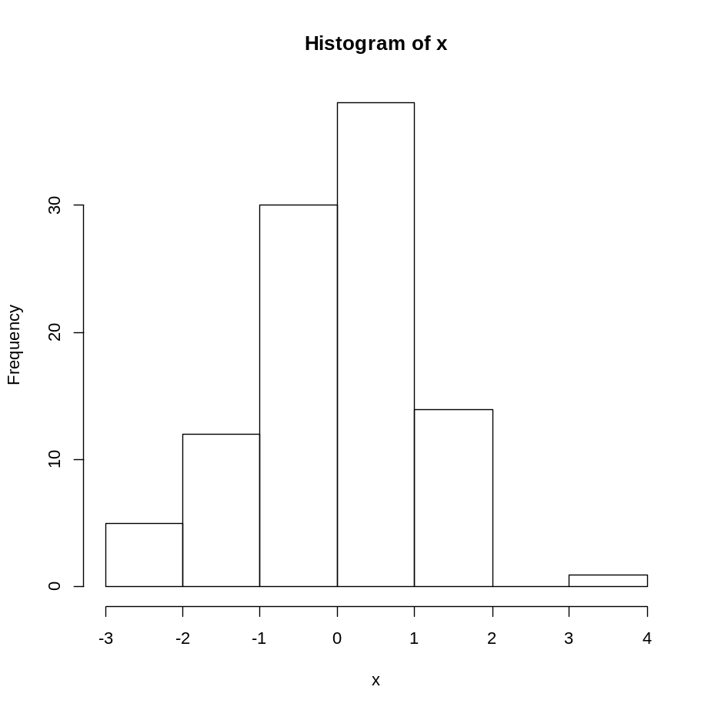
Histogram of the sample
> hist(x)

Slide 13
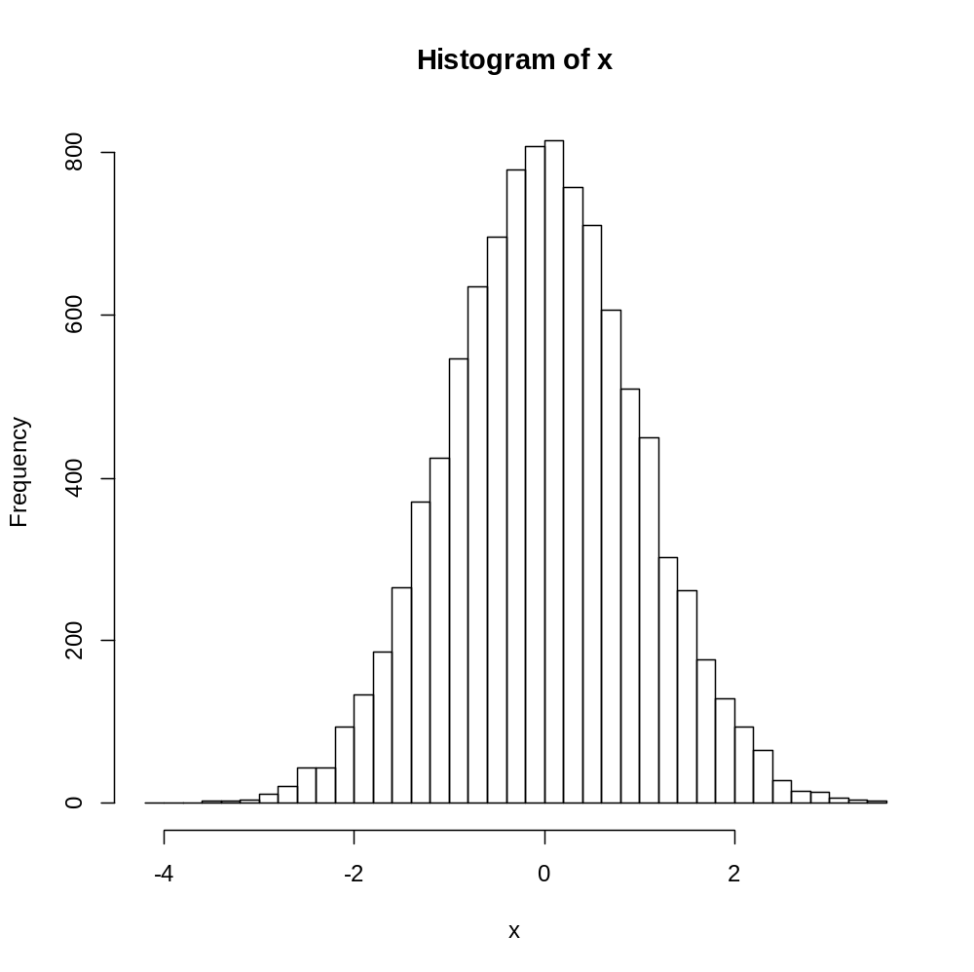
Histogram of the sample
> x<-rnorm(10000,0,1)
> mean(x)
[1] -0.01259969
> var(x)
[1] 0.9871957
> hist(x,nclass=50)

Slide 14
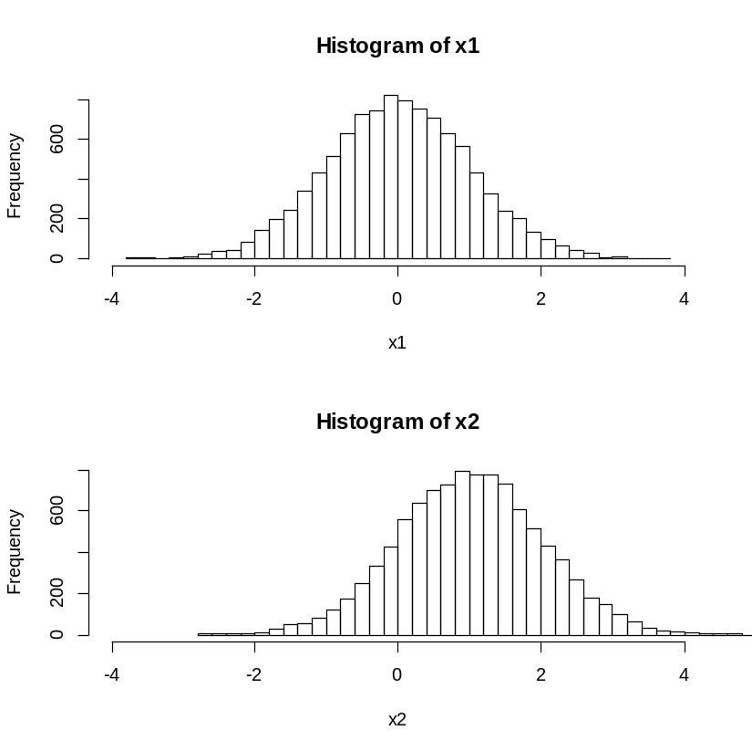
The normal distribution: location
> x1<-rnorm(10000,0,1)
> x2<-rnorm(10000,1,1)
> par(mfrow=c(2,1))
> hist(x1,nclass=50,xlim=c(-4,4))
> hist(x2,nclass=50,xlim=c(-4,4))

Slide 15
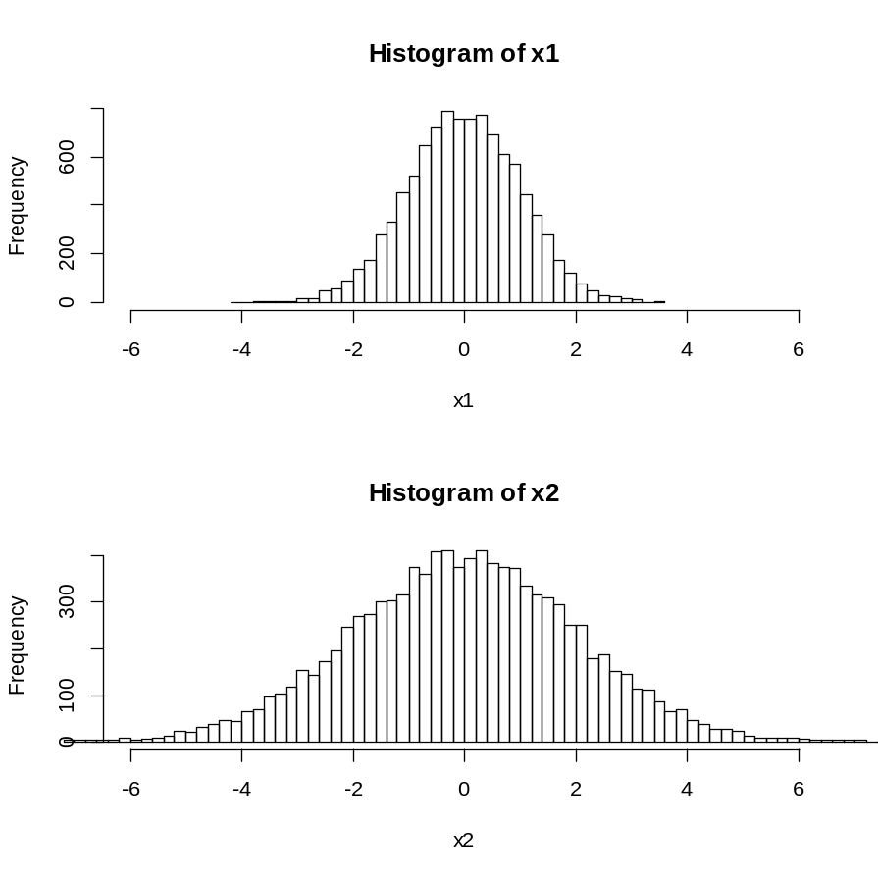

The normal distribution: variability
> x1<-rnorm(10000,0,1)
> x2<-rnorm(10000,0,2)
> par(mfrow=c(2,1))
> hist(x1,nclass=50,xlim=c(-6,6))
> hist(x2,nclass=100,xlim=c(-6,6))

Slide 16
Working with data

Slide 17
The cars Data set in R
Write cars in the script window.
Submit
> help(cars)
>
Speed and Stopping Distances of Cars
Description
The data give the speed of cars and the distances taken to stop. Note that the data were recorded in the 1920s.
> cars
speed dist
1 4 2
2 4 10
3 7 4
4 7 22
5 8 16
6 9 10
. . .
. . .
48 24 93
49 24 120
50 25 85
[,1] | speed | numeric | Speed (mph)
[,2] | dist | numeric | Stopping distance (ft)

Slide 18
The cars Data set in R: the $ sign
> speed
Error: object 'speed' not found
>
> cars$speed
[1] 4 4 7 7 8 9 10 10 10 11 11 12 12 12 12 13 13 13 13 14 14 14 14 15 15
[26] 15 16 16 17 17 17 18 18 18 18 19 19 19 20 20 20 20 20 22 23 24 24 24 24 25
>

Slide 19
The cars Data set in R: creating a new object
> cars[,1]
[1] 4 4 7 7 8 9 10 10 10 11 11 12 12 12 12 13 13 13 13 14 14 14 14 15 15
[26] 15 16 16 17 17 17 18 18 18 18 19 19 19 20 20 20 20 20 22 23 24 24 24 24 25
> x=cars[,1]
> print(x)
[1] 4 4 7 7 8 9 10 10 10 11 11 12 12 12 12 13 13 13 13 14 14 14 14 15 15
[26] 15 16 16 17 17 17 18 18 18 18 19 19 19 20 20 20 20 20 22 23 24 24 24 24 25
>

Slide 20
Basic plot and descriptive statistics
What is the average speed of the cars ?
What is the variance of the cars’ speed ?
What is the min. (max.) speed ?
What is the association between speed and stopping distance ?

Slide 21
Descriptive statistics
> mean(cars$speed)
[1] 15.4
> max(cars$speed)
[1] 25
> min(cars$speed)
[1] 4
> head(cars)
speed dist
1 4 2
2 4 10
3 7 4
4 7 22
5 8 16
6 9 10
The variable speed in the dataset cars

Slide 22
attach(data)
> attach(cars)
> mean(speed)
[1] 15.4
> max(speed)
[1] 25
> min(speed)
[1] 4
Tells R to work with the dataset cars.
We can work with the variables by using thier names.
Stop using the dataset cars.
> detach(cars)

Slide 23
Descriptive statistics
Correlation between the variables speed and stopping distance.
> cor(cars)
speed dist
speed 1.0000000 0.8068949
dist 0.8068949 1.0000000

Slide 24
R functions
function(data)
A procedure that was programed in R that uses data to produce output.
Calculate the variance.
> var(cars$speed)
[1] 27.95918
> var(cars$speed)
function
data

Slide 25
R functions
> print(cars)
speed dist
1 4 2
2 4 10
3 7 4
4 7 22
45 23 54
46 24 70
47 24 92
48 24 93
49 24 120
50 25 85
> cor(cars)
speed dist
speed 1.0000000 0.8068949
dist 0.8068949 1.0000000

Slide 26
R functions
Can be used for
  Data analysis: descriptive statistics, testing, modeling, etc.
  Data manipulation: selection of cases, variables…
  Data management: reading and writing datasets into/from R.
  Visualization: plots for the data.
  …..

Slide 27
Discussion
R Objects: data frame.
R functions.
$.

Slide 28
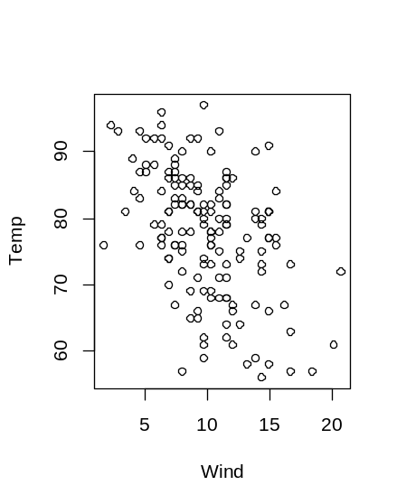
Practical session 1
The airquality is a dataset available in R.
How many variables there are in the data ?
Define an R object which contain the information about the wind speed.
Calculate the mean, and variance for the wind speed.

Slide 29
Two-sample t-test

Slide 30
The sleep data in R
> help(sleep)
> sleep
extra group ID
1 0.7 1 1
2 -1.6 1 2
3 -0.2 1 3
4 -1.2 1 4
5 -0.1 1 5
. . . .
14 0.1 2 4
15 -0.1 2 5
16 4.4 2 6
17 5.5 2 7
18 1.6 2 8
19 4.6 2 9
20 3.4 2 10
Data which show the effect of two soporific drugs (increase in hours of sleep compared to control) on 10 patients.
extra | numeric | increase in hours of sleep
group | factor | drug given
ID | factor | patient ID

Slide 31
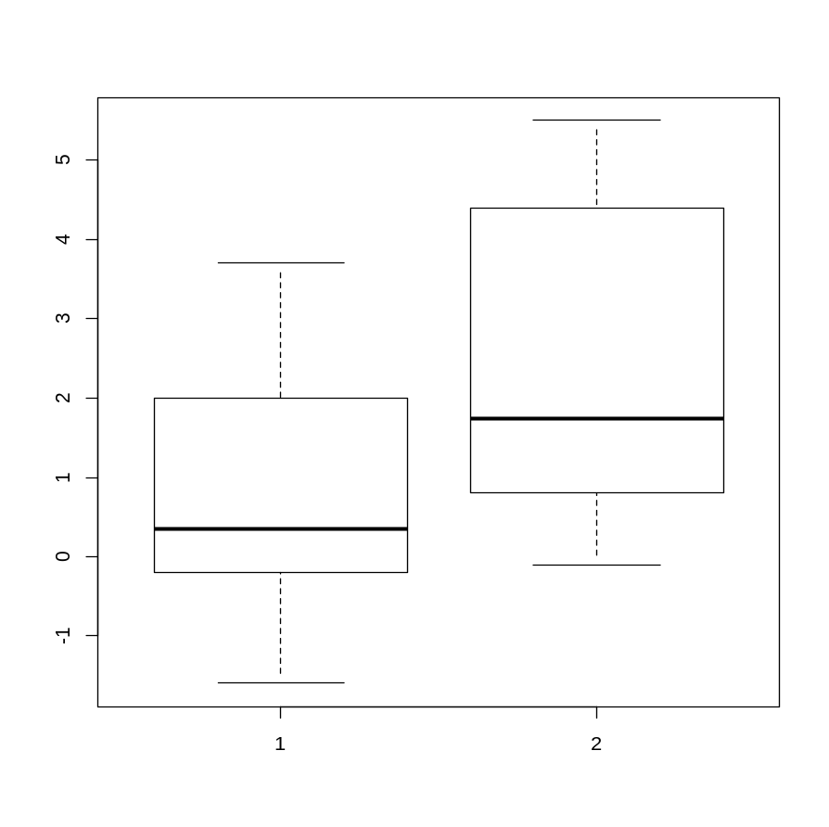
Two samples t-test
> extra=sleep$extra
> group=sleep$group
> boxplot(split(extra,group))
The aim of the analysis:
Test for a difference between the two soporific drugs

Slide 32
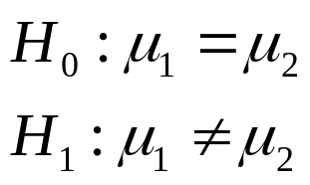
Two samples t-test
> t.test(extra~group,var.equal=TRUE)
Two Sample t-test
data: extra by group
t = -1.8608, df = 18, p-value = 0.07919
alternative hypothesis: true difference in means is not equal to 0
95 percent confidence interval:
-3.363874 0.203874
sample estimates:
mean in group 1 mean in group 2
0.75 2.33

Slide 33
Two samples t-test
> t.test(extra~group,var.equal=TRUE)
response
factor

Slide 34
R object for the output
> t.obj=t.test(extra~group,var.equal=TRUE)
> summary(t.obj)
Length Class Mode
statistic 1 -none- numeric
parameter 1 -none- numeric
p.value 1 -none- numeric
conf.int 2 -none- numeric
estimate 2 -none- numeric
null.value 1 -none- numeric
alternative 1 -none- character
method 1 -none- character
data.name 1 -none- character

Slide 35
R object for the output
> print(t.obj)
Two Sample t-test
data: extra by group
t = -1.8608, df = 18, p-value = 0.07919
alternative hypothesis: true difference in means is not equal to 0
95 percent confidence interval:
-3.363874 0.203874
sample estimates:
mean in group 1 mean in group 2
0.75 2.33
> t.obj$p.value
[1] 0.07918671
> t.obj$statistic
t
-1.860813
>

Slide 36
Discussion
R Objects: output of the analysis.
R functions: t.test
$.

Slide 37
Practical session 2
The ToothGrowth is a dataset available in R.
Use help(ToothGrowth) for more details.
The response variable is the Tooth length.
Test if the Supplement type has an effect on the tooth length.
t.test(response ~ group, data = …)

Slide 38
Basic plots

Slide 39
The faithful data in R
> help(faithful)
> Faithful
eruptions waiting
1 3.600 79
2 1.800 54
3 3.333 74
4 2.283 62
5 4.533 85
6 2.883 55
7 4.700 88
8 3.600 85
9 1.950 51
Waiting time between eruptions and the duration of the eruption for the Old Faithful geyser in Yellowstone National Park, Wyoming, USA.

Slide 40
The faithful data in R
> faithful$eruption
[1] 3.600 1.800 3.333 2.283 4.533 2.883 4.700 3.600 1.950 4.350 1.833 3.917 ,..., .4.750 4.117 2.150 4.417 1.817 4.467
> mean(faithful$eruption)
[1] 3.487783
aithful$eruption
> mean(x)
[1] 3.487783
> median(x)
[1] 4
> range(x)
[1] 1.6 5.1
> min(x)
[1] 1.6
> max(x)
[1] 5.1

Slide 41
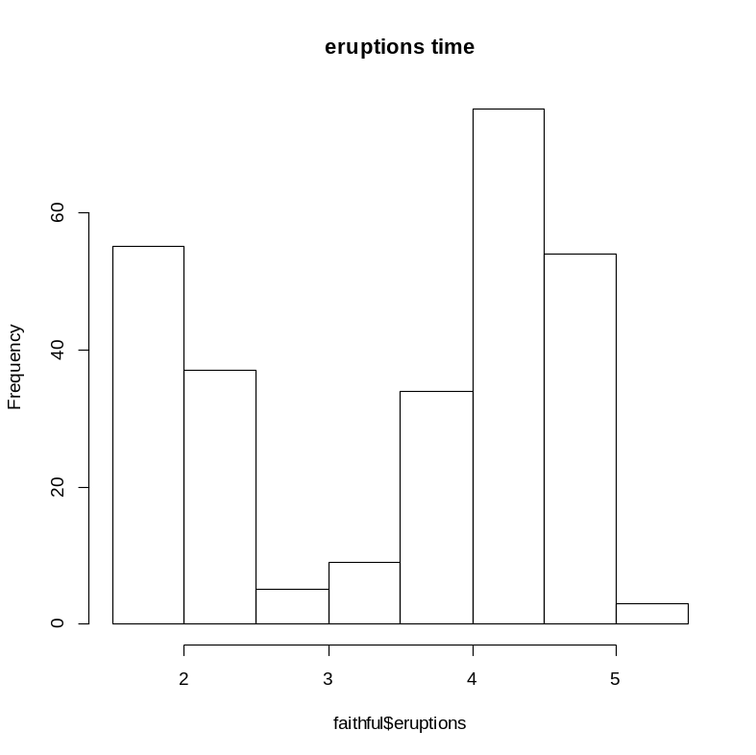
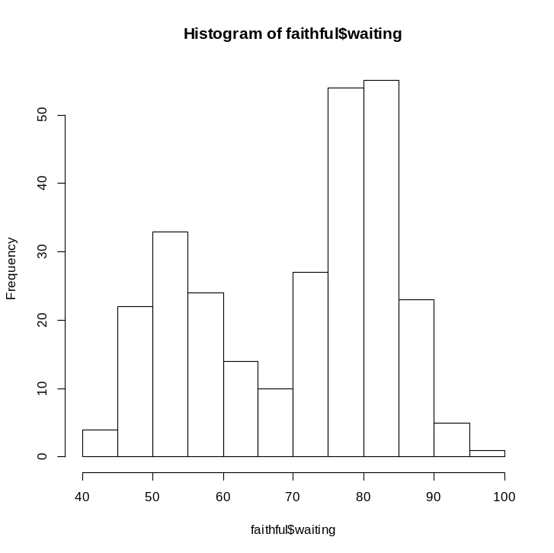
Basic plot
> hist(faithful$waiting)
>hist(faithful$eruptions,
main="eruptions time")

Slide 42
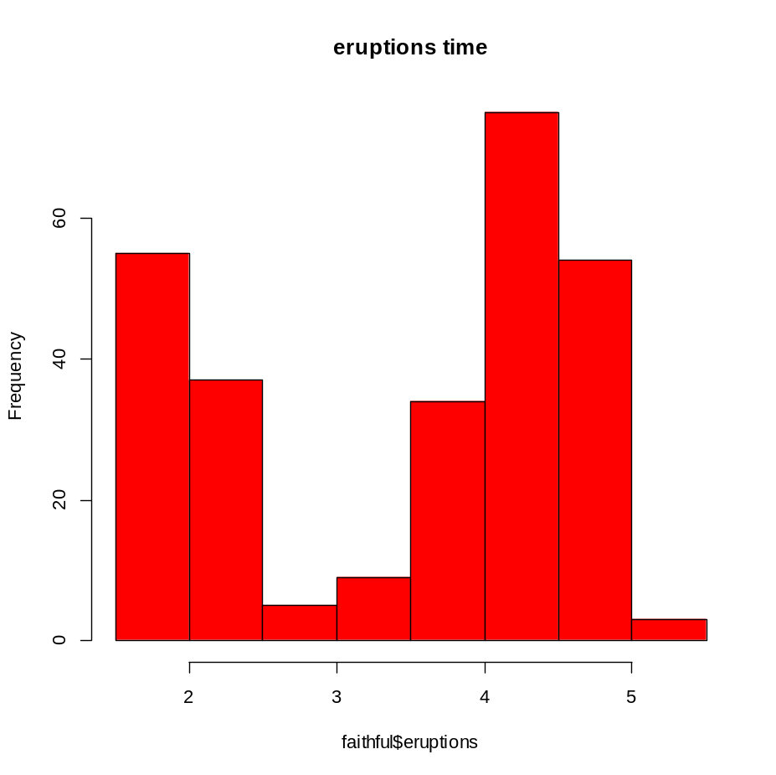
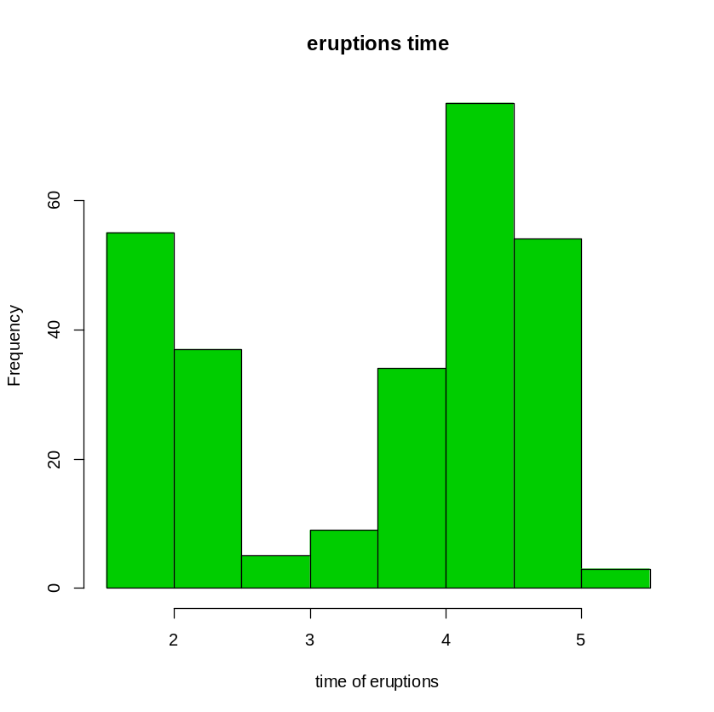
Basic plot
>hist(faithful$eruptions,
main="eruptions time",
col=2)
>hist(faithful$eruptions,
main="eruptions time",
col=3,
xlab="time of eruptions")

Slide 43
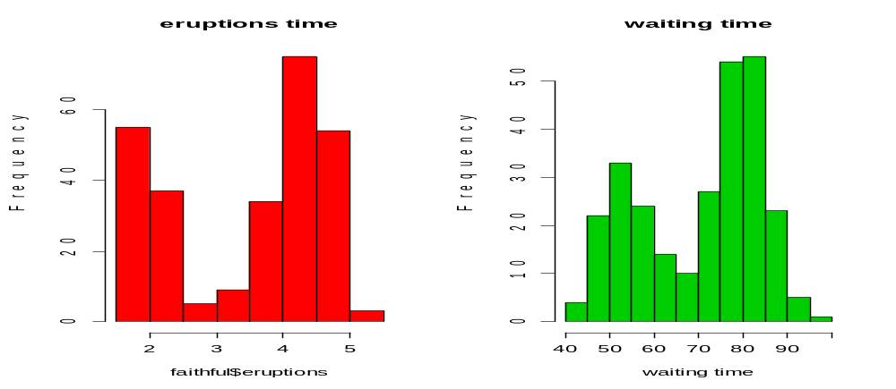
Basic plot
> mfrow=c(1,2))
> hist(faithful$eruptions,main="eruptions time",col=2)
> hist(faithful$waiting,main="waiting
time",col=3,xlab="waiting time")

Slide 44
Practical session 3
Use the ToothGrowth data.
Produce an histogram for the tooth length with the following structure.
tooth length
histogram
x

Slide 45
Chapter 1
Basic programming
Objects in R

Slide 46
Simple objects
Assign the value of 5 to the R object x
> x <- 5
> x
[1] 5
> x^2
[1] 25
> x + 6
[1] 11

Slide 47
Vectors
> x<-c("A","A","A","A","B","B","B","B")
> x
[1] "A" "A" "A" "A" "B" "B" "B" "B"
> y<-c(10,11,9,15,3,5,7,2)
> y
[1] 10 11 9 15 3 5 7 2

Slide 48
Index vectors
> ya<-y[x=="A"]
> ya
[1] 10 11 9 15
> yb<-y[x=="B"]
> yb
[1] 3 5 7 2
> tapply(y,x,mean)
A B
11.25 4.25
y[x=="A"]
All the elements in y for which x=A

Slide 49
Data frames
A data structure which contains more than 1 object.
Objects can be numeric objects and character objects
> z<-data.frame(x,y)
> z
x y
1 A 10
2 A 11
3 A 9
4 A 15
5 B 3
6 B 5
7 B 7
8 B 2

Slide 50
The $
> z$x
[1] A A A A B B B B
Levels: A B
> z$y
[1] 10 11 9 15 3 5 7 2
The object x in z

Slide 51
Matrix
> w<-c(1,2,40,2,3,9,200,4,6000)
> matw<-matrix(w,3,3)
> matw
[,1] [,2] [,3]
[1,] 1 2 200
[2,] 2 3 4
[3,] 40 9 6000

Slide 52
Rows and columns
X_{ij}=x[i,j]
> w1<-matw[1,]
> w2<-matw[,2]
> w1
[1] 1 2 200
> w2
[1] 2 3 9

Slide 53
The matrix reloaded
> matw+10
[,1] [,2] [,3]
[1,] 11 12 210
[2,] 12 13 14
[3,] 50 19 6010
>
[1] 1 3 6000

Slide 54
The inverse matrix
> solve(matw)
[,1] [,2] [,3]
[1,] -0.687854189 0.39056517 0.0226680962
[2,] 0.453361924 0.07658141 -0.0151631184
[3,] 0.003905652 -0.00271864 0.0000382907
> solve(matw)%*%(matw)
[,1] [,2] [,3]
[1,] 1.000000e+00 9.714451e-17 1.998401e-15
[2,] 5.551115e-17 1.000000e+00 -8.104628e-15
[3,] 4.336809e-19 -4.336809e-19 1.000000e+00

Slide 55
Example: data frame
> x<-c(25,36,21)
> gender<-c("M","M","F")
> data.frame(x,gender)
x gender
1 25 M
2 36 M
3 21 F

Slide 56
Example: an R object of a data frame
> x<-c(25,36,21)
> gender<-c("M","M","F")
> xdat<-data.frame(x,gender)
> xdat
x gender
1 25 M
2 36 M
3 21 F
> xdat$gender
[1] M M F
Levels: F M

Slide 57
Practical session 4
Create the folowig data frame:
A 100
B 99
C 105
D 35
E 0
F 250

Slide 58
Chapter 2
Reading external datasets

Slide 59
Read an external file (text file)
> spwh3<-read.table('c:\\projects\\wseda\\spwh3.txt',
header=FALSE,na.strings="NA", dec=".")
> dim(spwh3)
[1] 60 4
> spwh3<-data.frame(spwh3)
> names(spwh3)<-c("id","y","x1","gender")

Slide 60
Read an external file (csv file)
> gsw.ts <- read.csv("C:/projects/NBA/GSW_TS.csv",header =
FALSE,sep =";")

Slide 61
The data
The sleep data in R
> spwh3
id y x1 gender
1 1 10.111368 1 0
2 2 9.948930 1 0
3 3 10.322560 1 0
4 4 10.241052 1 0
5 5 9.911427 1 0
6 6 9.357969 1 0
7 7 10.649141 1 0
8 8 10.150197 1 0
9 9 9.403218 1 0
10 10 8.027072 1 0
11 11 20.020056 1 1
> sleep
extra group ID
1 0.7 1 1
2 -1.6 1 2
3 -0.2 1 3
4 -1.2 1 4
5 -0.1 1 5
. . . .
14 0.1 2 4
15 -0.1 2 5
16 4.4 2 6
17 5.5 2 7
18 1.6 2 8
19 4.6 2 9
20 3.4 2 10

Slide 62
Two samples t-test
> y1<-spwh3$y[spwh3$gender==0]
> y2<-spwh3$y[spwh3$gender==1]
> t.test(y1,y2)
Welch Two Sample t-test
data: y1 and y2
t = -9.1428, df = 58, p-value = 7.715e-13
alternative hypothesis: true difference in means is not equal to 0
95 percent confidence interval:
-12.229889 -7.836547
sample estimates:
mean of x mean of y
14.99933 25.03254

Slide 63
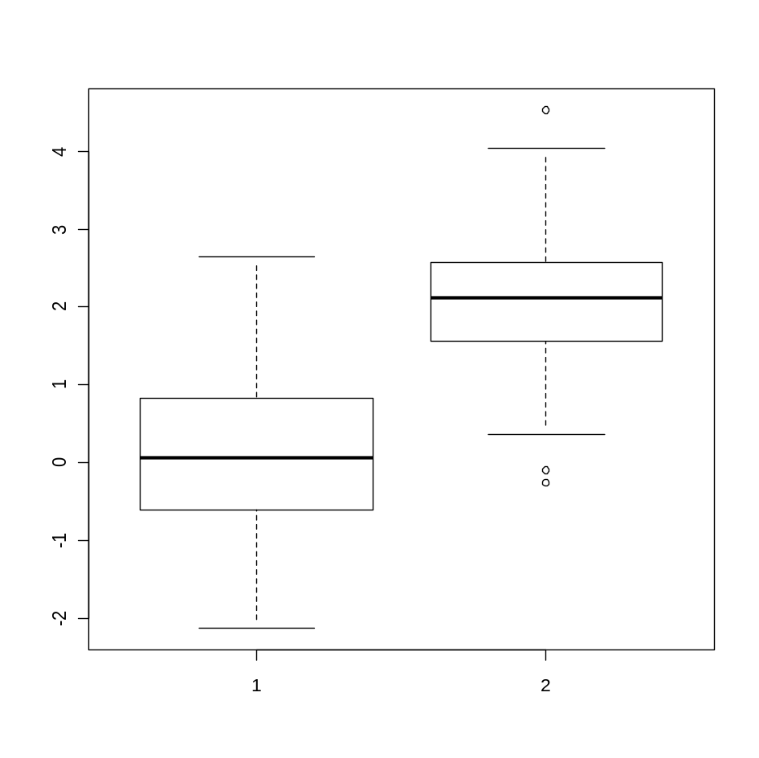
Two samples t-test
> y1<-rnorm(100,0,1)
> y2<-rnorm(57,2,1)
> boxplot(y1,y2)

Slide 64
Two samples t-test
> t.test(y1,y2)
Welch Two Sample t-test
data: y1 and y2
t = -14.2203, df = 126.176, p-value < 2.2e-16
alternative hypothesis: true difference in means is not equal to 0
95 percent confidence interval:
-2.290641 -1.730980
sample estimates:
mean of x mean of y
-0.0063866 2.0044240

Slide 65
R object for the output
> t.t<-t.test(y1,y2)
> summary(t.t)
Length Class Mode
statistic 1 -none- numeric
parameter 1 -none- numeric
p.value 1 -none- numeric
conf.int 2 -none- numeric
estimate 2 -none- numeric
null.value 1 -none- numeric
alternative 1 -none- character
method 1 -none- character
data.name 1 -none- character

Slide 66
R object for the output
> t.t
Welch Two Sample t-test
data: y1 and y2
t = -14.2203, df = 126.176, p-value < 2.2e-16
alternative hypothesis: true difference in means is not equal to 0
95 percent confidence interval:
-2.290641 -1.730980
sample estimates:
mean of x mean of y
-0.0063866 2.0044240
> t.t$p.value
[1] 5.570543e-28
> t.t$statistic
t
-14.22034
t.t<-t.test(y1,y2)

Slide 67
Practical session 5
Create the following text file:
and read it to R as an external file
A 100
B 99
C 105
D 35
E 0
F 250

Slide 68
Chapter 3
Basic plots functions

Slide 69
Descriptive statistics in R
> z<-rnorm(100,3,1)
> mean(z)
[1] 2.979706
> median(z)
[1] 2.958521
> max(z)
[1] 5.849559
> min(z)
[1] 0.877219
Generate random sample from N(3,1)

Slide 70
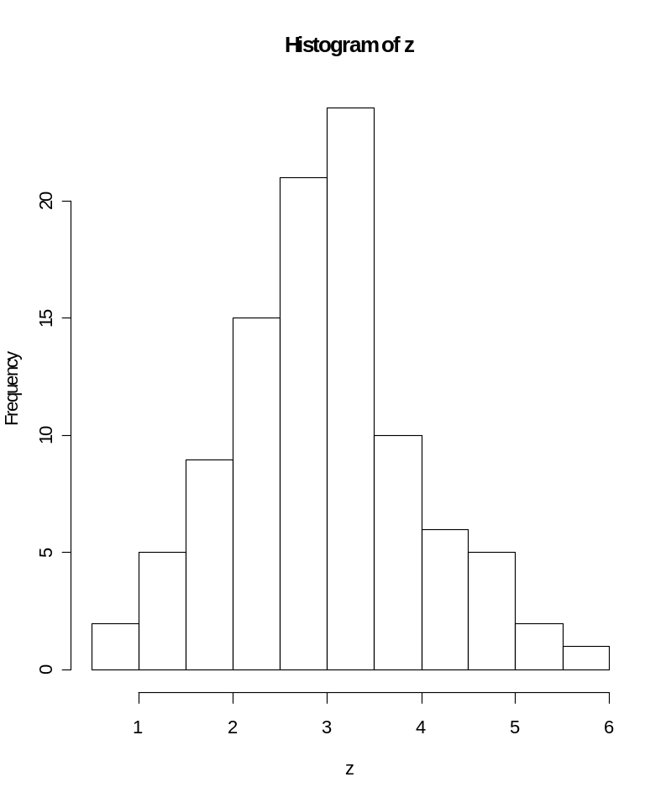
Histogram
> hist(z)

Slide 71
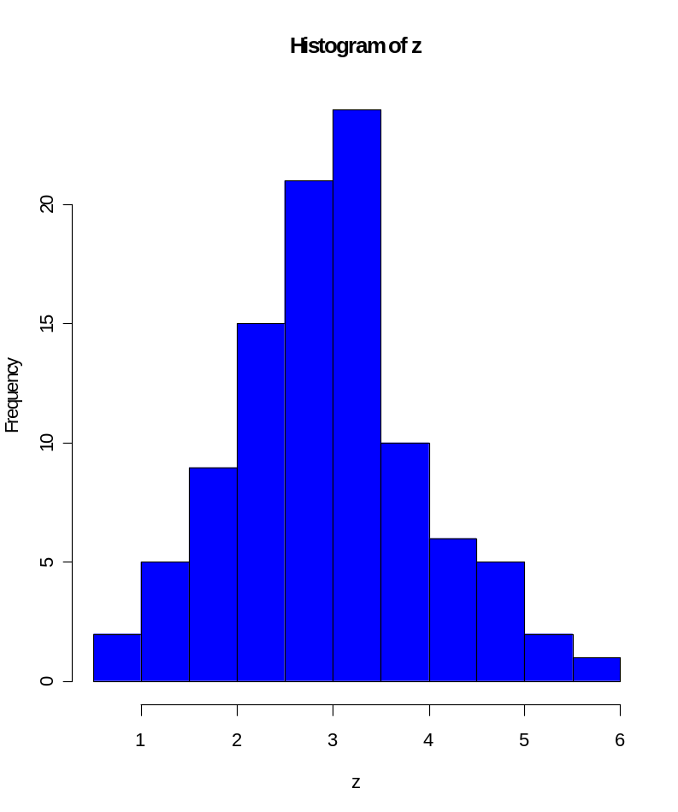
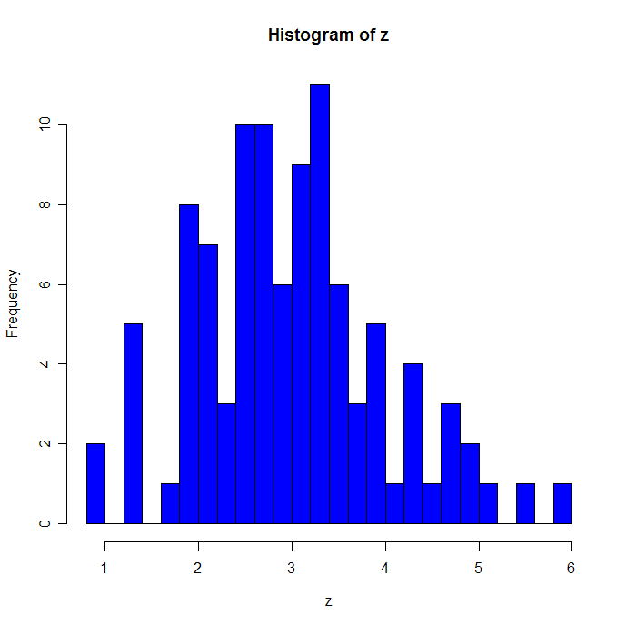
Plot options
> hist(z,col=4)
> hist(z,col=4,nclass=25)

Slide 72
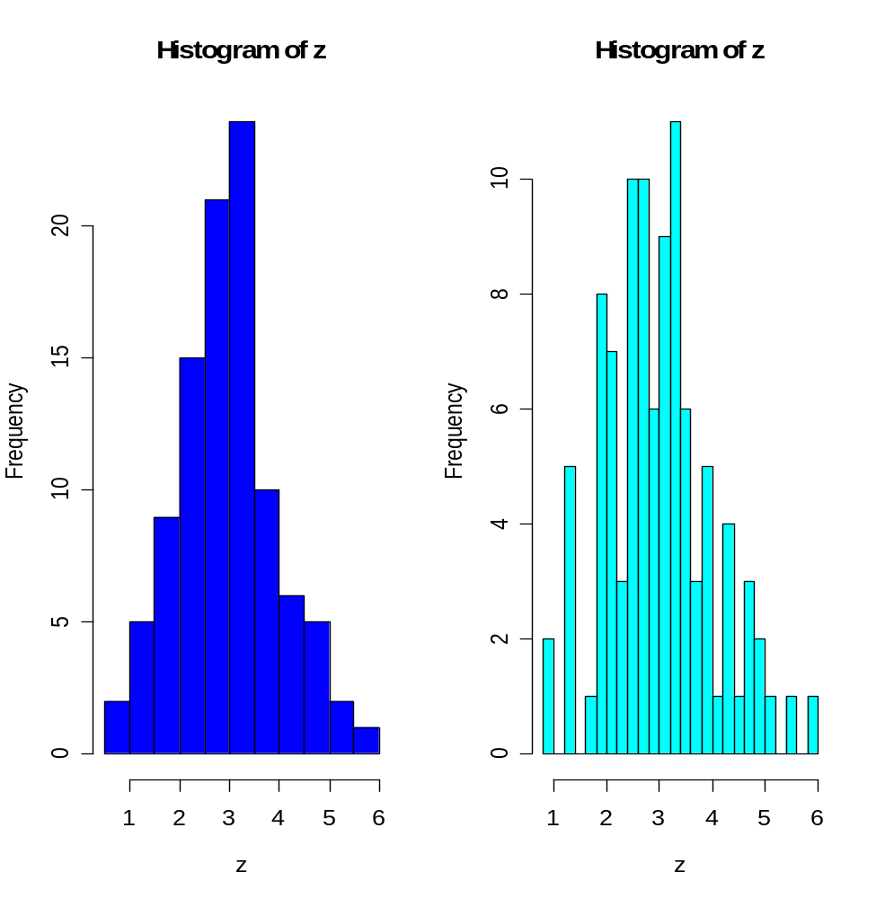
Controlling the graphical output: the par() function
> par(mfrow=c(1,2))
> hist(z,col=4)
> hist(z,col=5,nclass=25)
Fig 1
Fig 2

Slide 73
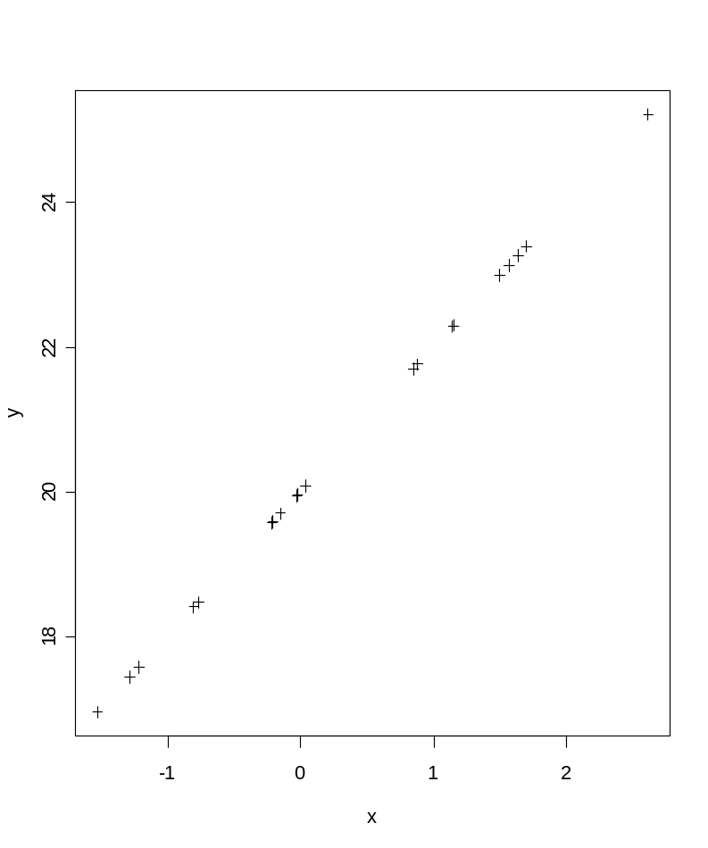
Type of points: the pch() function
> y<-2*x+20
> plot(x,y)
> plot(x,y,pch=3)

Slide 74

Type of points: the pch() function
>plot(x,y,pch="+")

Slide 75
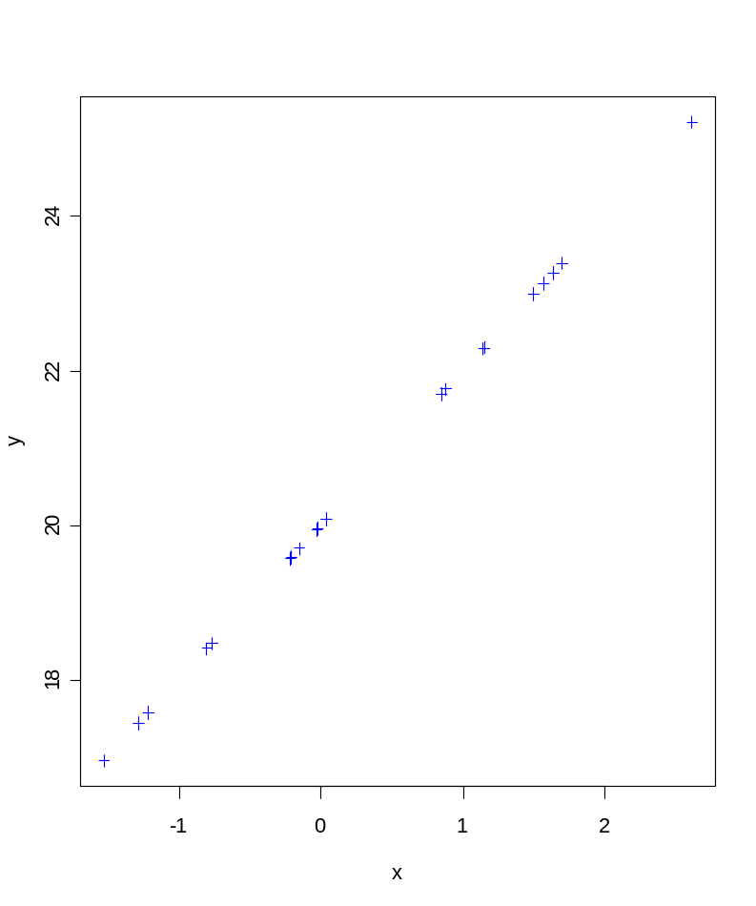
Colors: the option col
> plot(x,y,pch=" ")
> points(x,y,col=4,pch=3)

Slide 76
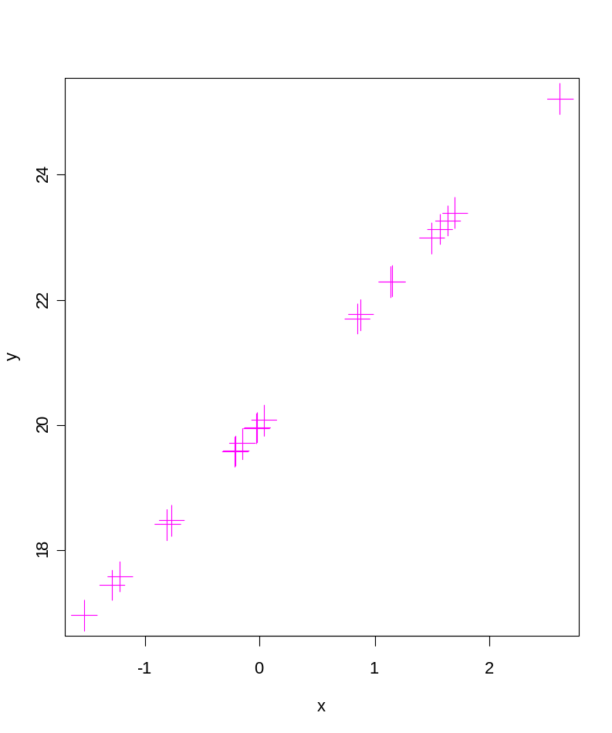
Size: the option cex
> plot(x,y,pch=" ")
> points(x,y,col=6,pch=3,cex=3)

Slide 77
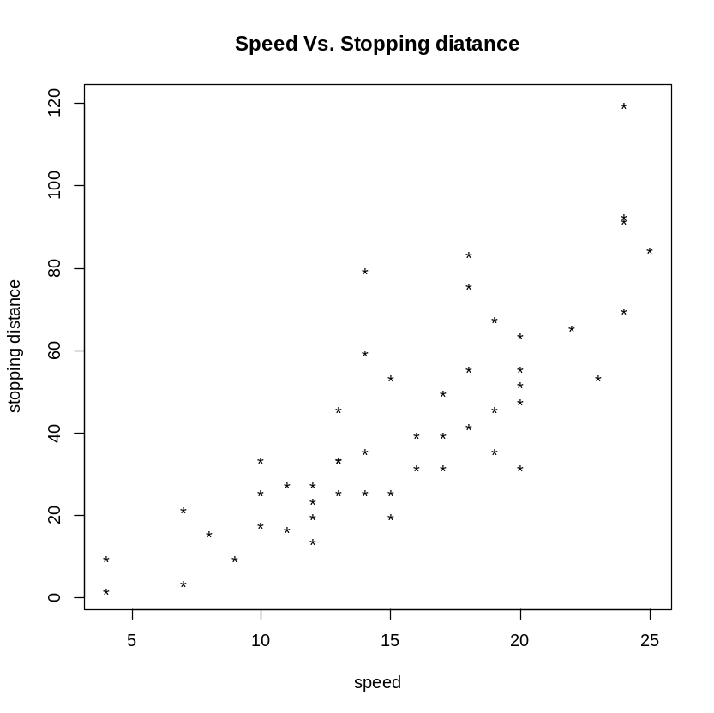
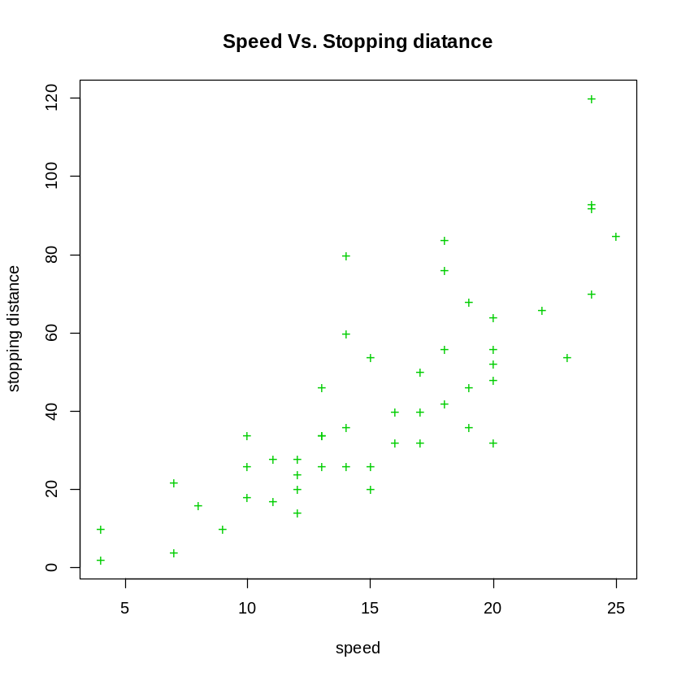
Practical session 6
Produce the following figures in R (use the cars data)

Slide 78
Practical session 7
Use the airquality in R.
Produce the following plots:
  Histogram for the ozone level
  Boxplot for the ozone level.
What is the mean and the median of the ozone level.
What is the minimum and maximum ozone levels.

Slide 79
Chapter 4
Programming I: A for loop

Slide 80
A for loop
for(i in 1:B)
{
}
Here you ask from R to do the same thing B times…..

Slide 81
Generate 1000 samples from N(2,1)
> x<-rnorm(10,2,1)
> x
[1] 2.1531462 2.4426189 0.8080064 1.4051178 1.9392356 0.6466574
[7] 0.7519918 -0.1097367 2.3338487 3.7598694
> x<-rnorm(10,2,1)
> x
[1] 2.9694328 1.1065506 1.5612572 0.3904008 1.6890423 3.7319756 0.9026146
[8] 1.7763012 2.4356002 0.9643299

Slide 82
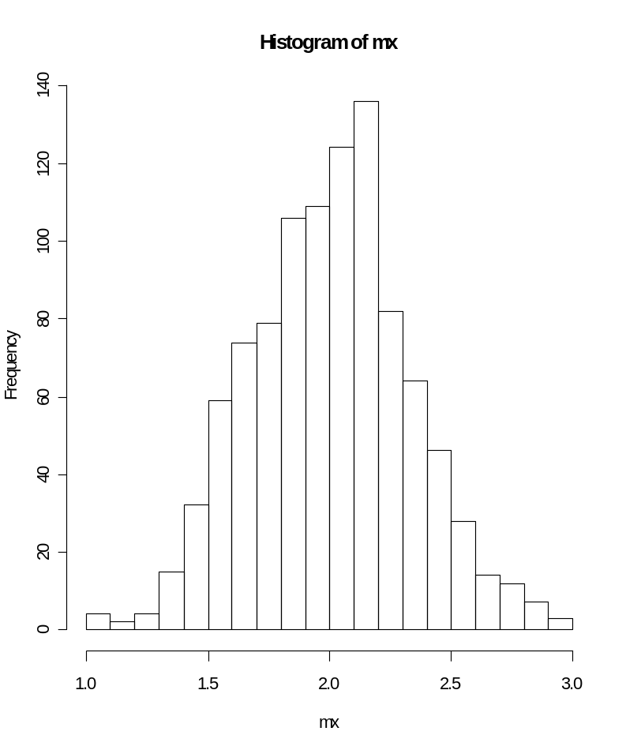
Generate 1000 samples from N(2,1)
> mx<-c(1:1000)
> for(i in 1:1000)
+ {
+ x<-rnorm(10,2,1)
+ mx[i]<-mean(x)
+ }
> hist(mx,nclass=25)

Slide 83
Example: distribution of the minimum in uniform distribution
Generate 1000 samples (n=50) from U(0,1).
Calculate the minimum of each sample.
Estimate the density of the minimum.

Slide 84
Example: distribution of the minimum in uniform distribution
Generate 1000 samples (n=50) from U(0,1).
Calculate the minimum of each sample.
Estimate the density of the minimum.

Slide 85
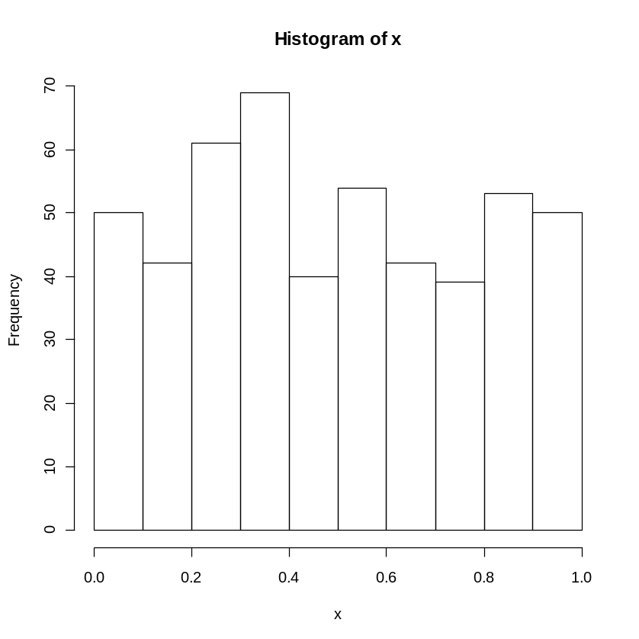
Example: distribution of the minimum in uniform distribution
Generate 1000 samples (n=50) from U(0,1).
Calculate the minimum of each sample.
> x<-runif(500,0,1)
> hist(x)
> min(x)
[1] 0.004631357

Slide 86
Example: distribution of the minimum in uniform distribution
Estimate the density of the minimum.
for(i in 1:B)
{
Generate 1000 samples (n=50) from U(0,1).
Calculate the minimum of each sample.
}

Slide 87
Example: distribution of the minimum in uniform distribution
Estimate the density of the minimum.
for(i in 1:B)
{
Generate 1000 samples (n=50) from U(0,1).
Calculate the minimum of each sample.
}
> mx<-c(1:1000)
> for(i in 1:1000)
+ {
+ x<-runif(500,0,1)
+ mx[i]<-min(x)
+ }

Slide 88
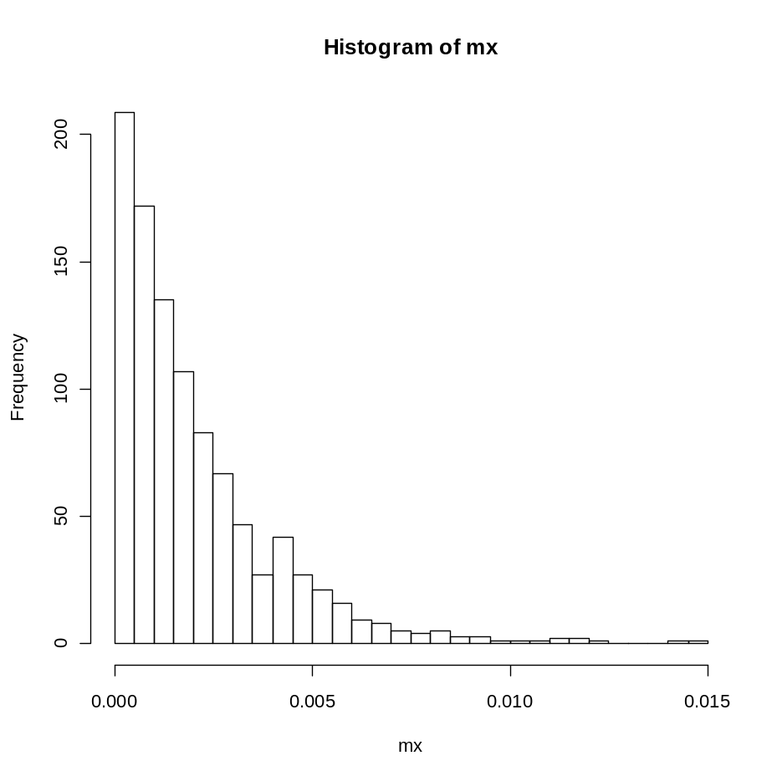
Example: distribution of the minimum in uniform distribution
Estimate the density of the minimum.
> mx<-c(1:1000)
> for(i in 1:1000)
+ {
+ x<-runif(500,0,1)
+ mx[i]<-min(x)
+ }
>hist(mx)

Slide 89
Practical session 8
Make a for loop that print your name 500 times.

Slide 90
Chapter 5
Statistical modeling 1:
Simple linear regression

Slide 91
Reading the cars data
> carsdat<-read.table('c:\\projects\\wseda\\Rintro\\cars.txt', header=FALSE,na.strings="NA", dec=".")
> dim(carsdat)
[1] 50 3
The data is available in R, use, help(cars)

Slide 92
The cars data
> help(cars)
cars package:datasets R Documentation
Speed and Stopping Distances of Cars
Description:
The data give the speed of cars and the distances taken to stop.
Note that the data were recorded in the 1920s.
Usage:
cars
Format:
A data frame with 50 observations on 2 variables.
[,1] speed numeric Speed (mph)
[,2] dist numeric Stopping distance (ft)
Source:
Ezekiel, M. (1930) _Methods of Correlation Analysis_. Wiley.

Slide 93
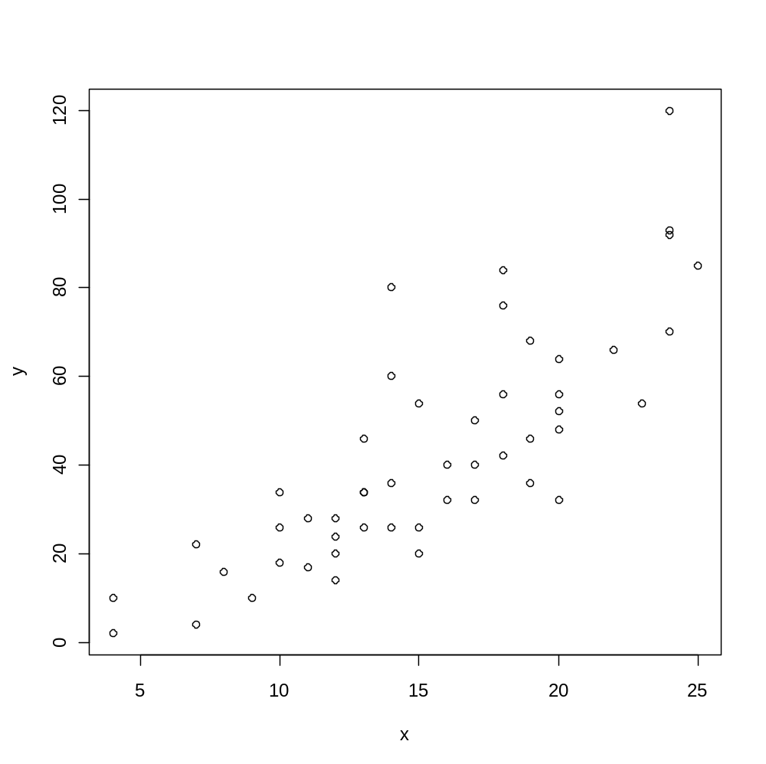
The cars data
> x<-carsdat[,2]
> y<-carsdat[,3]
> plot(x,y)

Slide 94
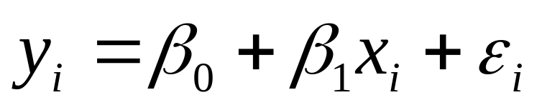
The lm() function
General call of the lm() function
lm(response~predictor)

Slide 95
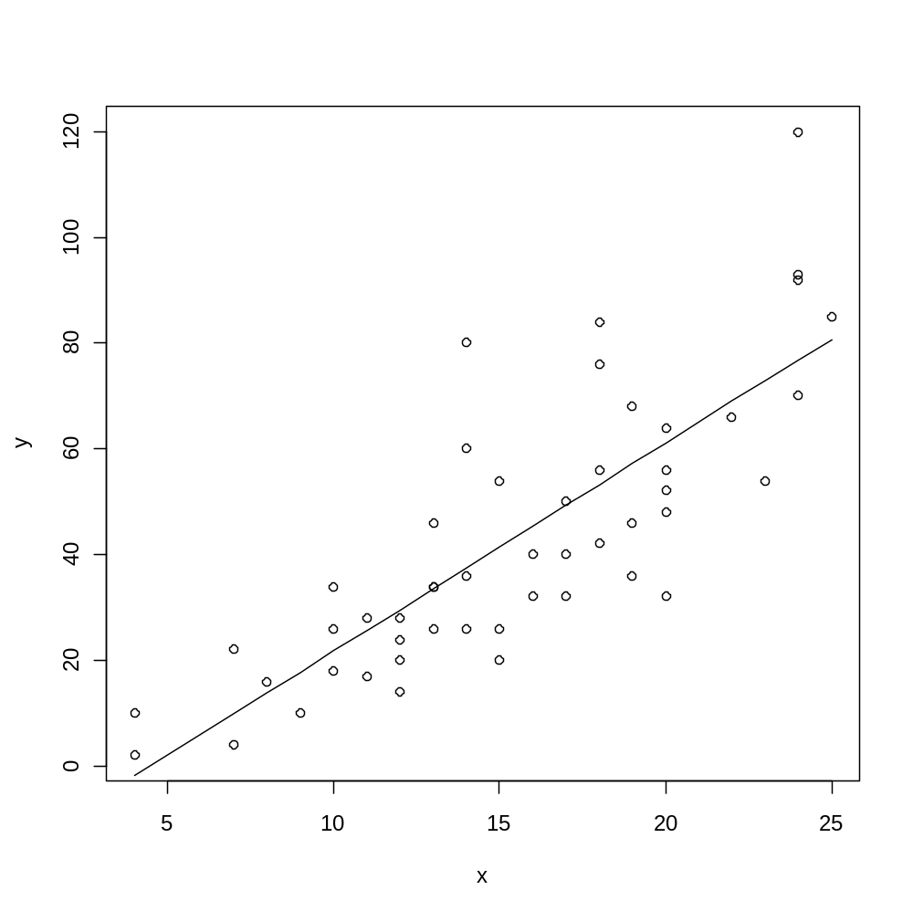
Data and predicted model
> fit.1<-lm(y~x)
> plot(x,y)
> lines(x,fit.1$fit)

Slide 96
The “output”
ANOVA table for the model
> summary(fit.1)
Call:
lm(formula = y ~ x)
Residuals:
Min 1Q Median 3Q Max
-29.069 -9.525 -2.272 9.215 43.201
Coefficients:
Estimate Std. Error t value Pr(>|t|)
(Intercept) -17.5791 6.7584 -2.601 0.0123 *
x 3.9324 0.4155 9.464 1.49e-12 ***
---
Signif. codes: 0 ‘***’ 0.001 ‘**’ 0.01 ‘*’ 0.05 ‘.’ 0.1 ‘ ’ 1
Residual standard error: 15.38 on 48 degrees of freedom
Multiple R-squared: 0.6511, Adjusted R-squared: 0.6438
F-statistic: 89.57 on 1 and 48 DF, p-value: 1.490e-12
Analysis of Variance Table
Response: y
Df Sum Sq Mean Sq F value Pr(>F)
x 1 21186 21185.5 89.567 1.490e-12 ***
Residuals 48 11354 236.5
---
Signif. codes: 0 ‘***’ 0.001 ‘**’ 0.01 ‘*’ 0.05 ‘.’ 0.1 ‘ ’ 1

Slide 97
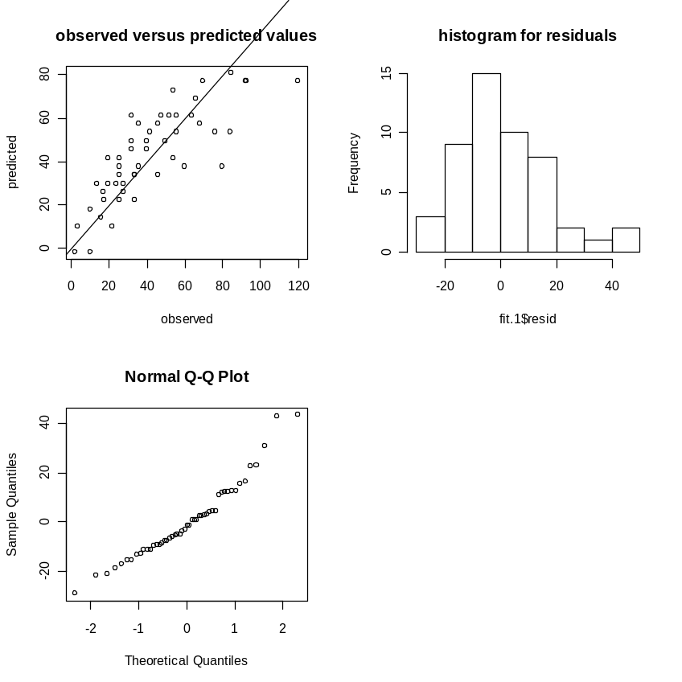
Graphical output
> par(mfrow=c(2,2))
> plot(y,fit.1$fit,xlab="observed",
ylab="predicted")
> abline(0,1)
> title("observed versus predicted values")
> hist(fit.1$resid,col=0,main=" ")
> title("histogram for residuals")
> qqnorm(fit.1$resid)

Slide 98
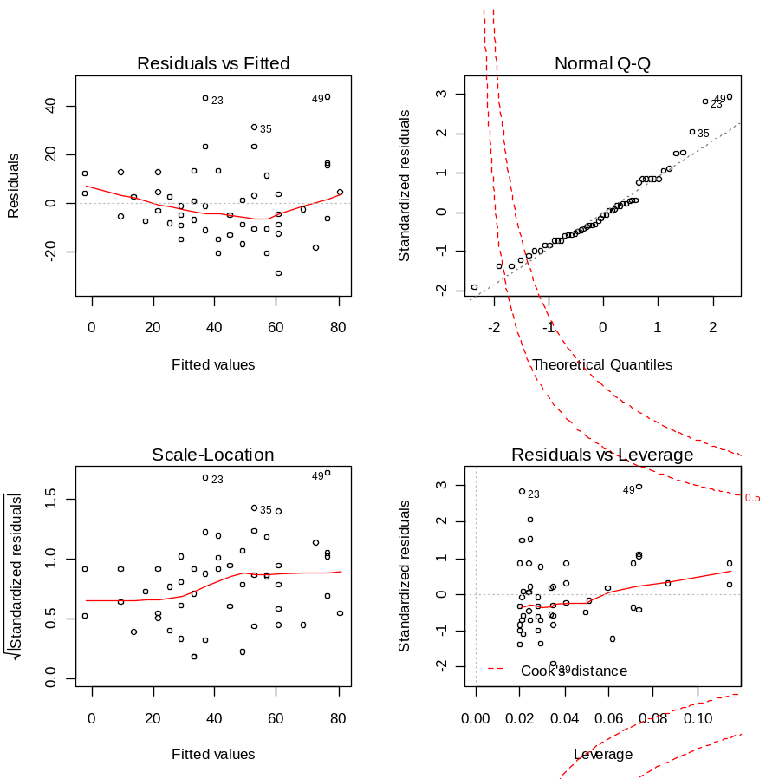
Default plots
> plot(fit.1)

Slide 99
Practical session 9
The airquality is a dataset available in R.
Fit a simple linear regression model in which the ozone level is the response and the wind speed is the predictor.
Test the hypothesis that the slope is zero.
Use the default plots of an lm() object to produce the diagnostic plot.

Slide 100
Chapter 6
Statistical modeling 2:
One way ANOVA
Examples:
The chick data
The cash data

Slide 101
Example 1: The chick dataset in R
> chickwts
weight feed
1 179 horsebean
2 160 horsebean
3 136 horsebean
4 227 horsebean
16 203 linseed
17 148 linseed
18 169 linseed
23 243 soybean
24 230 soybean
25 248 soybean
> help(chickwts)
An experiment was conducted to measure the effectiveness of various feed supplements on the growth rate of chickens.

Slide 102
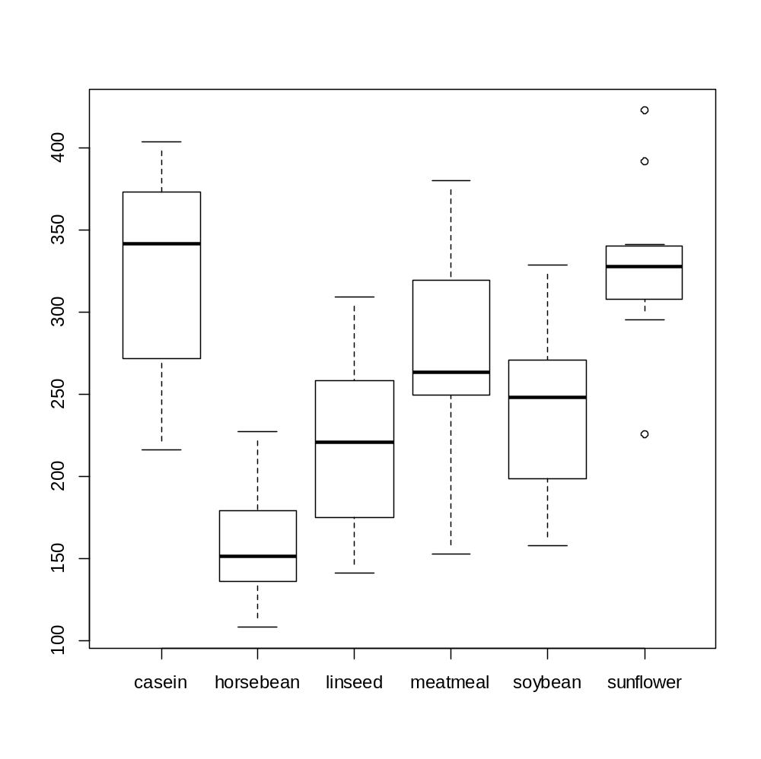
Boxplot by group
> w<-chickwts[,1]
> feed<-chickwts[,2]
> boxplot(split(w,feed))

Slide 103
Mean by group
> tapply(w,feed,mean)
casein horsebean linseed meatmeal soybean sunflower
323.5833 160.2000 218.7500 276.9091 246.4286 328.9167

Slide 104
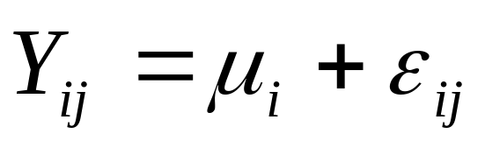
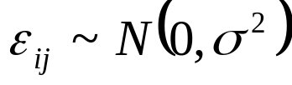
One-Way ANOVA model: model formulation
Random error, assumed to follow normal distribution with constant varaince.
Parameters: fixed but unknown and needed to be estimated
Model assumptions are:
The random error is nornal distributed.
The varaince is constant across the factor levels.

Slide 105
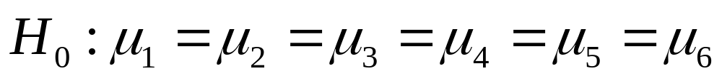


The Null Hypothesis: No diet effect
For a model in which the factor has 5 (the diet group) levels we wish to test the null hypothesis:
This means that we want to test if the means across all factor levels are equal.
Mind that: we test if the parameters ( ) are equal, not is the sample means ( ).

Slide 106
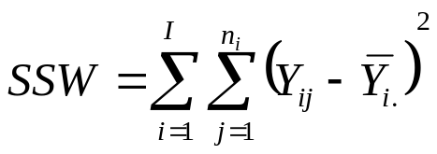
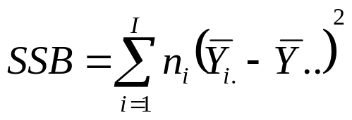
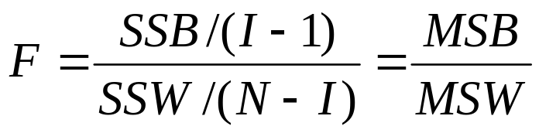
Test Statistic
Within group sum of squares
Between group sum of squares
The test statistic, F, is the ratio between the mean of the between sum of squares (SSB) and the mean of the within sum of squares.

Slide 107
The aov() function
aov(response ~ factor)
> a.model=aov(w~feed)
> summary(a.model)

Slide 108
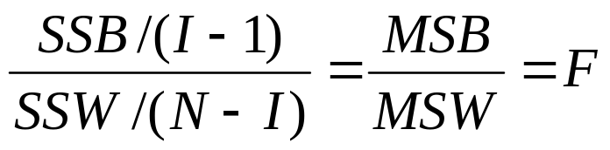
Test Statistic
Between group sum of squares/dgree of fredom
=
Within group sum of squares/dgree of fredom
> a.model=aov(w~feed)
> summary(a.model)
Df Sum Sq Mean Sq F value Pr(>F)
feed 5 231129 46226 15.37 5.94e-10 ***
Residuals 65 195556 3009
---
Signif. codes: 0 ‘***’ 0.001 ‘**’ 0.01 ‘*’ 0.05 ‘.’ 0.1 ‘ ’ 1

Slide 109
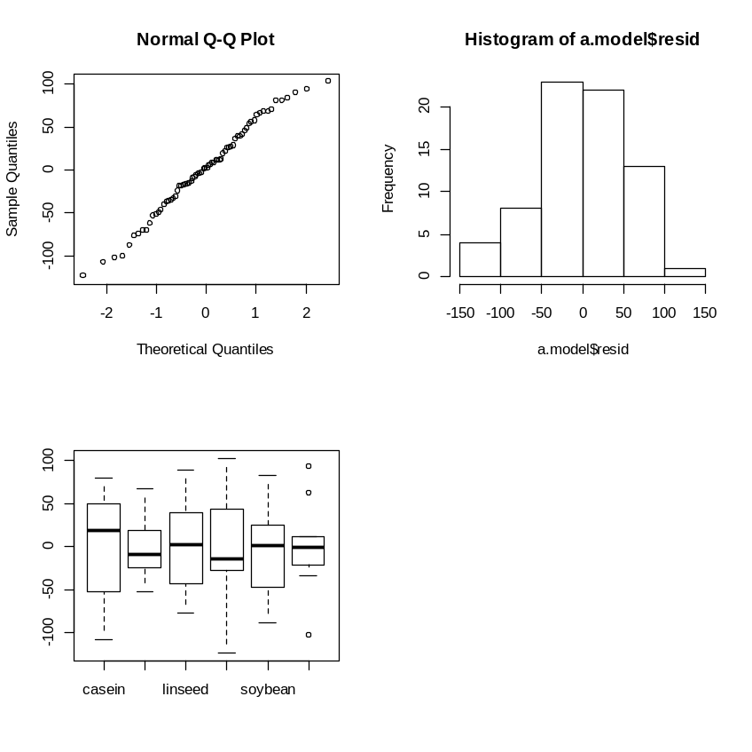
Diagnostic plot
> par(mfrow=c(2,2))
> qqnorm(a.model$resid)
> hist(a.model$resid,col=0)
> boxplot(split(a.model$resid,feed))

Slide 110
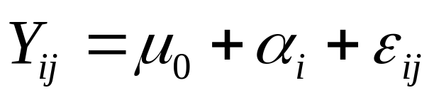
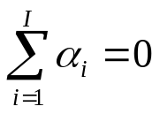
One-Way ANOVA model: alternative model formulation
Random error, assumed to follow normal distribution with constant varaince.
Mean of the reference group
Diet effect
Model assumptions are:
The random error is nornal distributed.
The varaince is constant across the factor levels.

Slide 111
Estimation of the model in R
lm(response~predictor)
> lm.fit<-lm(w~feed)

Slide 112
Estimation of the model in R
> summary(lm.fit)
Call:
lm(formula = w ~ feed)
Residuals:
Min 1Q Median 3Q Max
-123.909 -34.413 1.571 38.170 103.091
Coefficients:
Estimate Std. Error t value Pr(>|t|)
(Intercept) 323.583 15.834 20.436 < 2e-16 ***
feedhorsebean -163.383 23.485 -6.957 2.07e-09 ***
feedlinseed -104.833 22.393 -4.682 1.49e-05 ***
feedmeatmeal -46.674 22.896 -2.039 0.045567 *
feedsoybean -77.155 21.578 -3.576 0.000665 ***
feedsunflower 5.333 22.393 0.238 0.812495
---
Signif. codes: 0 ‘***’ 0.001 ‘**’ 0.01 ‘*’ 0.05 ‘.’ 0.1 ‘ ’ 1
Residual standard error: 54.85 on 65 degrees of freedom
Multiple R-squared: 0.5417, Adjusted R-squared: 0.5064
F-statistic: 15.36 on 5 and 65 DF, p-value: 5.936e-10
323.583: the mean of the casein
323.583-163.383= 160.2000, the mean of the horsebeen group

Slide 113

The AVOVA table
Residual standard error: 54.85 on 65 degrees of freedom
Multiple R-squared: 0.5417, Adjusted R-squared: 0.5064
F-statistic: 15.36 on 5 and 65 DF, p-value: 5.936e-10
> anova(lm.fit)
Analysis of Variance Table
Response: w
Df Sum Sq Mean Sq F value Pr(>F)
feed 5 231129 46226 15.365 5.936e-10 ***
Residuals 65 195556 3009
---
Signif. codes: 0 ‘***’ 0.001 ‘**’ 0.01 ‘*’ 0.05 ‘.’ 0.1 ‘ ’ 1

Slide 114
Example 2: Reading the cash data
> cashdat<-read.table('c:\\projects\\wseda\\Rintro\\cashdat.txt', header=FALSE,na.strings="NA", dec=".")
> dim(cashdat)
[1] 36 2
> names(cashdat)<-c("cash","group")
> attach(cashdat)

Slide 115
The data
> print(cashdat)
cash group
1 23 Young
2 25 Young
. . .
. . .
11 21 Young
12 21 Young
13 28 Middle
. . .
. . .
24 29 Middle
25 23 Elderly
26 20 Elderly
35 22 Elderly
36 21 Elderly

Slide 116
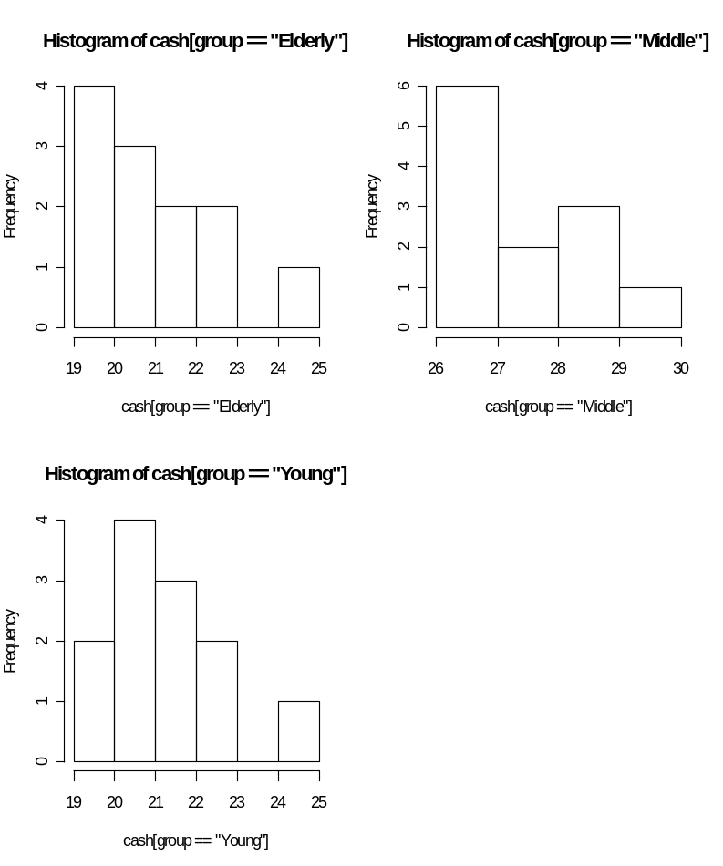
Histograms by group
> par(mfrow=c(2,2))
> hist(cash[group=="Elderly"],col=0)
> hist(cash[group=="Middle"],col=0)
> hist(cash[group=="Young"],col=0)

Slide 117
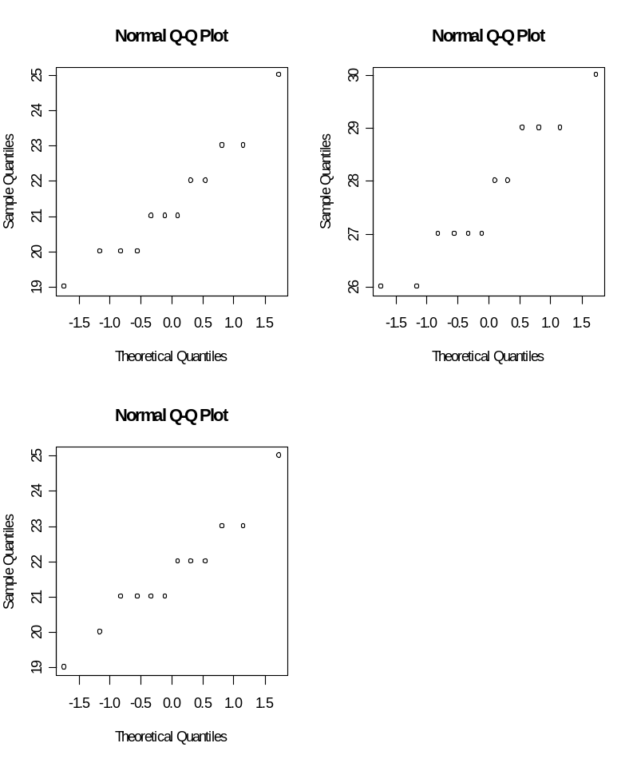
qq normal plots by group
> par(mfrow=c(2,2))
> qqnorm(cash[group=="Elderly"])
> qqnorm(cash[group=="Middle"])
> qqnorm(cash[group=="Young"])

Slide 118
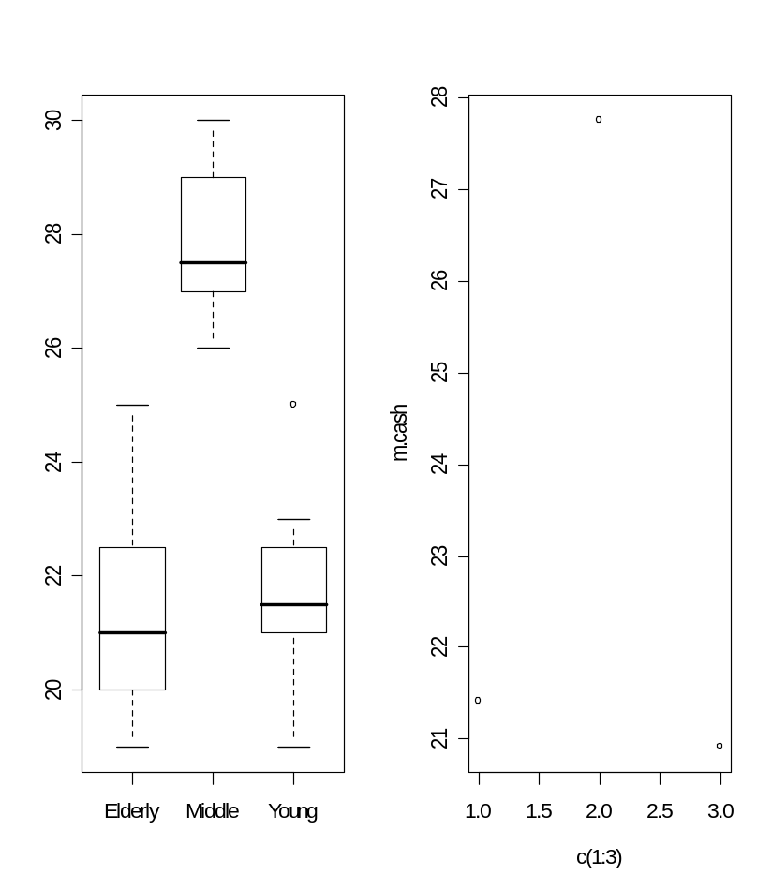
Boxplot and dotplot
> par(mfrow=c(1,2))
> boxplot(split(cash,group))
> tapply(cash,group,mean)
Elderly Middle Young
21.41667 27.75000 21.66667
> m.cash<-c(21.41667,27.75,20.91667)
> names1<-c("Elderly","Middle","Young")
> plot(c(1:3),m.cash)

Slide 119
One-Way ANOVA model: model formulation
Random error, assumed to follow normal distribution with constant varaince.
Parameters: fixed but unknown and needed to be estimated
Model assumptions are:
The random error is nornal distributed.
The varaince is constant across the factor levels.

Slide 120
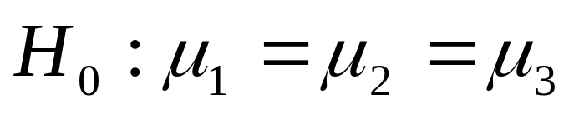
The Null Hypothesis: No treatment effect
For a model in which the factor has three levels we wish to test the null hypothesis:
This means that we want to test if the means across all factor levels are equal.
Mind that: we test if the parameters ( ) are equal, not is the sample means ( ).

Slide 121
Test Statistic
Within group sum of squares
Between group sum of squares
The test statistic, F, is the ratio between the mean of the between sum of squares (SSB) and the mean of the within sum of squares.

Slide 122
The aov() function
aov(response ~ factor)
>Fit.aov<-aov(cash~group)
>summary(Fit.aov)

Slide 123
Test Statistic
Between group sum of squares/dgree of fredom
=
Within group sum of squares/dgree of fredom
> summary(Fit.aov)
Df Sum Sq Mean Sq F value Pr(>F)
group 2 308.722 154.361 67.172 2.322e-12 ***
Residuals 33 75.833 2.298
---
Signif. codes: 0 ‘***’ 0.001 ‘**’ 0.01 ‘*’ 0.05 ‘.’ 0.1 ‘ ’ 1

Slide 124
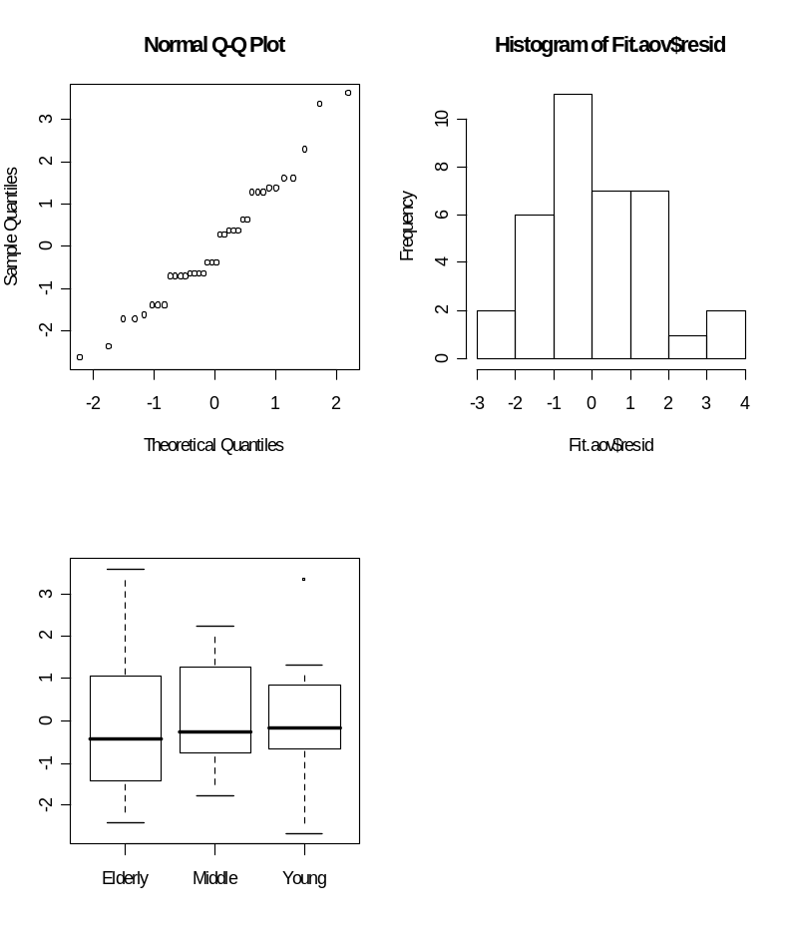
Diagnostic plot
> par(mfrow=c(2,2))
> qqnorm(Fit.aov$resid)
> hist(Fit.aov$resid,col=0)
> boxplot(split(Fit.aov$resid,group))

Slide 125
Practical session 10 (a)
Create the following data frame in R
y treatment
1 10 A
2 12 A
3 13 A
4 15 A
5 10 B
6 9 B
7 9 B
8 11 B
9 10 C
10 15 C
11 13 C
12 8 C
Use one-way ANOVA model to test the null hypothesis of no treatment effect

Slide 126
Practical session 10 (b)
Create the following data frame in R
y treatment
1 10 A
2 12 A
3 13 A
4 15 A
5 10 B
6 9 B
7 9 B
8 11 B
9 10 C
10 15 C
11 13 C
12 8 C
Use one-way ANOVA model to test the null hypothesis of no treatment effect

Slide 127
Chapter 7
Statistical modeling 3:
Logistic regression
Examples:
Serological data

Slide 128
Example : Serological data of malaria
In this example the information about each subject in the experiment is the disease status (infected or not by malaria) and the age group of the subject.
The variables are: the sample size, the number of sero-positive at each sample size (=the number of infected subjects) and the age.

Slide 129

Example : serological data
Age group | Mid age | Sero positive | Sample size
 | 1.5 | 8 | 123
 | 4.0 | 6 | 132
 | 7.5 | 18 | 182
 | 12.5 | 14 | 140
 | 17.5 | 20 | 138
 | 25.0 | 39 | 161
 | 35.0 | 19 | 133
 | 47.0 | 25 | 92
 | 60.0 | 44 | 74
44/74
25/92

Slide 130
Reading the data
> sero<-read.table('c:\\projects\\wseda\\Rintro\\sero1.txt', header=FALSE,na.strings="NA", dec=".")
> print(sero)
V1 V2 V3 V4
1 1 1.5 123 8
2 2 4.0 132 6
3 3 7.5 182 18
4 4 12.5 140 14
5 5 17.5 138 20
6 6 25.0 161 39
7 7 35.0 133 19
8 8 47.0 92 25
9 9 60.0 74 44

Slide 131




Example : serological data
Mid age | Sero positive | Sample size
1.5 | 8 | 123
4.0 | 6 | 132
7.5 | 18 | 182
12.5 | 14 | 140
17.5 | 20 | 138
25.0 | 39 | 161
35.0 | 19 | 133
47.0 | 25 | 92
60.0 | 44 | 74
Number of sero-positive at each age group
n_{i}: sample size at each age group
P_{i} is the probability to be infected (the prevalence). We use logistic regression in order to model the prevalence as a function of age

Slide 132

The probability of infection
If β>0 then there is a positive association between the probability and age. This means that the probability of infection increase with age.
If β<0 then there is a negative association between the probability and age. This means that the probability of infection decrease with age.

Slide 133

The glm() function
glm(pos/ntot ~ age, family=binomial(link = "logit"))

Slide 134
The glm() function
> fit.glm<- glm(pos/ntot ~ age, family=binomial(link = "logit"))
> summary(fit.glm)
Call:
glm(formula = pos/ntot ~ age, family = binomial(link = "logit"))
Deviance Residuals:
Min 1Q Median 3Q Max
-0.24364 -0.09726 0.01479 0.06756 0.19568
Coefficients:
Estimate Std. Error z value Pr(>|z|)
(Intercept) -2.79677 1.79832 -1.555 0.120
age 0.04718 0.04668 1.011 0.312
(Dispersion parameter for binomial family taken to be 1)
Null deviance: 1.31775 on 8 degrees of freedom
Residual deviance: 0.18094 on 7 degrees of freedom
AIC: 8.062
Number of Fisher Scoring iterations: 5

Slide 135



Data and predicted values

Slide 136
Chapter 8
Programming in R II:
User functions

Slide 137
Generate s random sample pf size 1000 from N(0,3)
> x<-rnorm(100,0,3)
> mean(x)
[1] 0.3080260
> median(x)
[1] 0.4176008
> quantile(x)
0% 25% 50% 75% 100%
-5.9877043 -1.7844439 0.4176008 1.5712923 8.5930491

Slide 138
A user function: general form
function name<-function(x)
{
}
R commands (what do you what that the function will do for you……)

Slide 139
A user function: example
fch20<-function(x)
{
mean.x<-mean(x)
med.x<-median(x)
q.x<-quantile(x)
hist(x)
return(mean.x,med.x,q.x)
}

Slide 140

A user function: output
> z<-runif(100,0,1)
> fch20(z)
$mean.x
[1] 0.4947539
$med.x
[1] 0.5291341
$q.x
0% 25% 50% 75% 100%
0.01240262 0.24212404 0.52913405 0.72482479 0.98413912
Warning message:
In return(mean.x, med.x, q.x) : multi-argument returns are deprecated
>

Slide 141
Practical session 11
Write a function which receive a numerical vector as an input and calculate the mean of the vector.

Slide 142
Chapter 9:
Statistical modeling : Two-way ANOVA

Slide 143






Model formulation
Overall mean
Main effect of factor A
Main effect of factor B
Interaction effect
Random error

Slide 144
Example 1: Reading the data
> spwh3<-read.table('c:\\projects\\wseda\\spwh3.txt', header=FALSE,na.strings="NA", dec=".")
> names(spwh3)<-c("id","y","x1","gender")

Slide 145
Example 1: The data
> print(spwh3)
id y x1 gender
1 1 10.111368 1 0
2 2 9.948930 1 0
3 3 10.322560 1 0
. . . . .
. . . . .
59 59 30.030490 3 1
60 60 29.541542 3 1
>
Both x1 and gender are numerical objects !!!!
For an ANOVA model the independent variables are suppose to be factors.

Slide 146
Example 2: The data
y f1 f2
1 10 A1 B1
2 11 A1 B1
3 12 A1 B1
4 9 A2 B1
5 7 A2 B1
6 6 A2 B1
7 11 A1 B2
8 13 A1 B2
9 14 A1 B2
10 7 A2 B2
11 5 A2 B2
12 8 A2 B2
Two factors: f1 and f2
Three observations per combination.
> f1<-c("A1","A1","A1","A2","A2","A2","A1","A1","A1","A2","A2","A2")
> f2<-c("B1","B1","B1","B1","B1","B1","B2","B2","B2","B2","B2","B2")
> y<-c(10,11,12,9,7,6,11,13,14,7,5,8)
> data.frame(y,f1,f2)

Slide 147


Which null hypotheses we test ?
No treatment effect of factor A
No treatment effect of factor B
No interaction effects

Slide 148
Example 1: A model without interaction
> fit.1<-aov(y~as.factor(x1)+as.factor(gender))
> anova(fit.1)
Analysis of Variance Table
Response: y
Df Sum Sq Mean Sq F value Pr(>F)
as.factor(x1) 2 1034.81 517.40 2244.8 < 2.2e-16 ***
as.factor(gender) 1 1509.98 1509.98 6551.3 < 2.2e-16 ***
Residuals 56 12.91 0.23
---
Signif. codes: 0 ‘***’ 0.001 ‘**’ 0.01 ‘*’ 0.05 ‘.’ 0.1 ‘ ’ 1

Slide 149
Example 1: A model with interaction
fit.2<-aov(y~as.factor(x1)+as.factor(gender)
+as.factor(x1)*as.factor(gender))
> anova(fit.2)
Analysis of Variance Table
Response: y
Df Sum Sq Mean Sq F value Pr(>F)
as.factor(x1) 2 1034.81 517.40 2171.959 <2e-16 ***
as.factor(gender) 1 1509.98 1509.98 6338.599 <2e-16 ***
as.factor(x1):as.factor(gender) 2 0.04 0.02 0.091 0.9131
Residuals 54 12.86 0.24
---
Signif. codes: 0 ‘***’ 0.001 ‘**’ 0.01 ‘*’ 0.05 ‘.’ 0.1 ‘ ’ 1
>

Slide 150
Example 1: Testing model 1 versus model 2
> anova(fit.1,fit.2)
Analysis of Variance Table
Model 1: y ~ as.factor(x1) + as.factor(gender)
Model 2: y ~ as.factor(x1) + as.factor(gender) + as.factor(x1) * as.factor(gender)
Res.Df RSS Df Sum of Sq F Pr(>F)
1 56 12.9073
2 54 12.8639 2 0.0434 0.091 0.9131
F-test for the interaction

Slide 151
Example 2: A model without interaction
> fit.1<-aov(y~f1+f2)
> anova(fit.1)
Analysis of Variance Table
Response: y
Df Sum Sq Mean Sq F value Pr(>F)
f1 1 70.083 70.083 31.4066 0.0003325 ***
f2 1 0.750 0.750 0.3361 0.5763122
Residuals 9 20.083 2.231
---
Signif. codes: 0 ‘***’ 0.001 ‘**’ 0.01 ‘*’ 0.05 ‘.’ 0.1 ‘ ’ 1

Slide 152
Example 2: A model with interaction
> fit.2<-aov(y~f1+f2+f1*f2)
> anova(fit.2)
Analysis of Variance Table
Response: y
Df Sum Sq Mean Sq F value Pr(>F)
f1 1 70.083 70.083 35.0417 0.0003539 ***
f2 1 0.750 0.750 0.3750 0.5572922
f1:f2 1 4.083 4.083 2.0417 0.1909016
Residuals 8 16.000 2.000
---
Signif. codes: 0 ‘***’ 0.001 ‘**’ 0.01 ‘*’ 0.05 ‘.’ 0.1 ‘ ’ 1

Slide 153
Example 2: Testing model 1 versus model 2
> anova(fit.1,fit.2)
Analysis of Variance Table
Model 1: y ~ f1 + f2
Model 2: y ~ f1 + f2 + f1 * f2
Res.Df RSS Df Sum of Sq F Pr(>F)
1 9 20.083
2 8 16.000 1 4.0833 2.0417 0.1909
F-test for the interaction

Slide 154
Example 2: means by factor level
> tapply(y,f1,mean)
A1 A2
11.83333 12.00000
> tapply(y,f2,mean)
B1 B2
9.166667 14.666667
> ind<-list(f1,f2)
> ind
[[1]]
[1] "A1" "A1" "A1" "A2" "A2" "A2" "A1" "A1" "A1" "A2" "A2" "A2"
[[2]]
[1] "B1" "B1" "B1" "B1" "B1" "B1" "B2" "B2" "B2" "B2" "B2" "B2"
> m<-tapply(y,ind,mean)
> m
B1 B2
A1 11.000000 12.66667
A2 7.333333 16.66667
Factor 1
Factor 2
Cell means

Slide 155

Interaction plot: Example 2
Cell means
B1 B2
A1 11.000000 12.666667
A2 7.333333 6.666667
A1
A2
B1
B2

Slide 156
Example 3: The data
y f1 f2
1 10 A1 B1
2 11 A1 B1
3 12 A1 B1
4 9 A2 B1
5 7 A2 B1
6 6 A2 B1
7 11 A1 B2
8 13 A1 B2
9 14 A1 B2
10 17 A2 B2
11 15 A2 B2
12 18 A2 B2
Two factors: f1 and f2
Three observations per combination.
> f1<-c("A1","A1","A1","A2","A2","A2","A1","A1","A1","A2","A2","A2")
> f2<-c("B1","B1","B1","B1","B1","B1","B2","B2","B2","B2","B2","B2")
> y<-c(10,11,12,9,7,6,11,13,14,17,15,18)
> data.frame(y,f1,f2)

Slide 157
Example 3: A model with interaction
> fit.2<-aov(y~f1+f2+f1*f2)
> anova(fit.2)
Analysis of Variance Table
Response: y
Df Sum Sq Mean Sq F value Pr(>F)
f1 1 0.083 0.083 0.0417 0.8433536
f2 1 90.750 90.750 45.3750 0.0001471 ***
f1:f2 1 44.083 44.083 22.0417 0.0015517 **
Residuals 8 16.000 2.000
---
Signif. codes: 0 ‘***’ 0.001 ‘**’ 0.01 ‘*’ 0.05 ‘.’ 0.1 ‘ ’ 1

Slide 158
Example 3: means by factor level
> tapply(y,f1,mean)
A1 A2
11.83333 12.00000
> tapply(y,f2,mean)
B1 B2
9.166667 14.666667
> ind<-list(f1,f2)
> ind
[[1]]
[1] "A1" "A1" "A1" "A2" "A2" "A2" "A1" "A1" "A1" "A2" "A2" "A2"
[[2]]
[1] "B1" "B1" "B1" "B1" "B1" "B1" "B2" "B2" "B2" "B2" "B2" "B2"
> m<-tapply(y,ind,mean)
> m
B1 B2
A1 11.000000 12.66667
A2 7.333333 16.66667
Factor 1
Factor 2
Cell means

Slide 159

Interaction plot: Example 3
A1
Cell means
B1 B2
A1 11.000000 12.66667
A2 7.333333 16.66667
A2
B1
B2

Slide 160
Chapter 10
Statistical modeling :
More about two-way ANOVA

Slide 161
Reading the data
> spwh3<-read.table('c:\\projects\\wseda\\spwh3.txt', header=FALSE,na.strings="NA", dec=".")
> names(spwh3)<-c("id","y","x1","gender")
> attach(spwh3)

Slide 162
Two-way ANOVA model
> fit.2<-aov(y~as.factor(x1)+as.factor(gender)+as.factor(x1)*as.factor(gender))
> anova(fit.2)
Analysis of Variance Table
Response: y
Df Sum Sq Mean Sq F value Pr(>F)
as.factor(x1) 2 1034.81 517.40 2171.959 <2e-16 ***
as.factor(gender) 1 1509.98 1509.98 6338.599 <2e-16 ***
as.factor(x1):as.factor(gender) 2 0.04 0.02 0.091 0.9131
Residuals 54 12.86 0.24
---
Signif. codes: 0 ‘***’ 0.001 ‘**’ 0.01 ‘*’ 0.05 ‘.’ 0.1 ‘ ’ 1

Slide 163
Stepwise procedure
> slm1 <- step(fit.2)
Start: AIC=-80.4
y ~ as.factor(x1) + as.factor(gender) + as.factor(x1) * as.factor(gender)
Df Sum of Sq RSS AIC
- as.factor(x1):as.factor(gender) 2 0.043 12.907 -84.193
<none> 12.864 -80.395
Step: AIC=-84.19
y ~ as.factor(x1) + as.factor(gender)
Df Sum of Sq RSS AIC
<none> 12.91 -84.19
- as.factor(x1) 2 1034.81 1047.72 175.60
- as.factor(gender) 1 1509.98 1522.89 200.04

Slide 164
Stepwise procedure
> summary(slm1)
Df Sum Sq Mean Sq F value Pr(>F)
as.factor(x1) 2 1034.81 517.40 2244.8 < 2.2e-16 ***
as.factor(gender) 1 1509.98 1509.98 6551.3 < 2.2e-16 ***
Residuals 56 12.91 0.23
---
Signif. codes: 0 ‘***’ 0.001 ‘**’ 0.01 ‘*’ 0.05 ‘.’ 0.1 ‘ ’ 1

Slide 165
Chapter 11
Statistical modeling :
More about Linear regression

Slide 166
Reading the data
> spwh2<-read.table('c:\\projects\\wseda\\spwh2.txt', header=FALSE,
+ ,na.strings="NA", dec=".")
> dim(spwh2)
[1] 100 5
>
> names(spwh2)<-c("id","y","x1","x2","x3")
> attach(spwh2)
The following object(s) are masked from spwh2 ( position 3 ) :
id x1 x2 x3 y

Slide 167
Fitting two models
> fit.1<-lm(y~x1+x2)
> anova(fit.1)
Analysis of Variance Table
Response: y
Df Sum Sq Mean Sq F value Pr(>F)
x1 1 164.2 164.2 27.152 1.059e-06 ***
x2 1 7409.7 7409.7 1224.980 < 2.2e-16 ***
Residuals 97 586.7 6.0
---
Signif. codes: 0 ‘***’ 0.001 ‘**’ 0.01 ‘*’ 0.05 ‘.’ 0.1 ‘ ’ 1
> fit.2<-lm(y~x1+x2+x3)
> anova(fit.2)
Analysis of Variance Table
Response: y
Df Sum Sq Mean Sq F value Pr(>F)
x1 1 164.2 164.2 758.98 < 2.2e-16 ***
x2 1 7409.7 7409.7 34241.81 < 2.2e-16 ***
x3 1 566.0 566.0 2615.44 < 2.2e-16 ***
Residuals 96 20.8 0.2
---
Signif. codes: 0 ‘***’ 0.001 ‘**’ 0.01 ‘*’ 0.05 ‘.’ 0.1 ‘ ’ 1

Slide 168
Testing model 1 versus model 2
> anova(fit.1,fit.2)
Analysis of Variance Table
Model 1: y ~ x1 + x2
Model 2: y ~ x1 + x2 + x3
Res.Df RSS Df Sum of Sq F Pr(>F)
1 97 586.74
2 96 20.77 1 565.97 2615.4 < 2.2e-16 ***
---
Signif. codes: 0 ‘***’ 0.001 ‘**’ 0.01 ‘*’ 0.05 ‘.’ 0.1 ‘ ’ 1

Slide 169

> par(mfrow=c(2,2))
> plot(fit.2)

Slide 170
Single terms deletions
> drop1(fit.2, test="F")
Single term deletions
Model:
y ~ x1 + x2 + x3
Df Sum of Sq RSS AIC F value Pr(F)
<none> 20.8 -149.1
x1 1 76.6 97.4 3.4 354.21 < 2.2e-16 ***
x2 1 7865.3 7886.1 442.8 36347.01 < 2.2e-16 ***
x3 1 566.0 586.7 182.9 2615.44 < 2.2e-16 ***
---
Signif. codes: 0 ‘***’ 0.001 ‘**’ 0.01 ‘*’ 0.05 ‘.’ 0.1 ‘ ’ 1

Slide 171
AIC and likelihood
> AIC(fit.2)
[1] 136.6403
> logLik(fit.2)
'log Lik.' -63.32017 (df=5)

Slide 172
Chapter 12
Application : the for loop
The bootstrap estimate of the standard error for the mean

Slide 173

The observed data
A sample of 10 observations:
> x <- c(11.201, 10.035, 11.118, 9.055, 9.434, 9.663, 10.403, 11.662, 9.285,8.84)
> mean(x)
[1] 10.0696
We wish to estimate the standard error of the sample mean

Slide 174



Parametric and nonparametric bootstrap
nonparametric bootstrap
parametric bootstrap
We assume a parametric model for F
We resample from the empirical distribution
We resample from

Slide 175



Nonparametric bootstrap
The data (x_{i})
Bootstrap sample (x_{i})*
Bootstrap sample (x_{i})*
Bootstrap sample (x_{i})*

Slide 176

Nonparametric bootstrap

Slide 177

Nonparametric bootstrap
The data (x_{i})
Bootstrap sample (x_{i})*
Bootstrap sample (x_{i})*
Bootstrap sample (x_{i})*

Slide 178
R code
> var(mx)
[1] 0.09357364
n<-length(x)
B<-1000
mx<-c(1:B)
for(i in 1:B){
cat(i)
boot.i<-sample(x,n,replace=T)
mx[i]<-mean(boot.i)
}
The estimated standard error 0.093

Slide 179
Nonparametric bootstrap

Slide 180


Parametric bootstrap
We assume a parametric model for F
We estimate F by
We replace the unknown parameters in F with their plug-in estimates

Slide 181


Parametric bootstrap
The data (x_{i})
Bootstrap sample (x_{i})*
Bootstrap sample (x_{i})*
Bootstrap sample (x_{i})*

Slide 182
R code
> var(mx)
[1] 0.1007613
Bootstrap estimate for the
standard error for the mean
B<-1000
MLx<-mean(x)
Varx<-var(x)
mx<-c(1:B)
for(i in 1:B){
cat(i)
boot.i<-rnorm(n,MLx,sqrt(Varx))
mx[i]<-mean(boot.i)
}

Slide 183

Parametric bootstrap

